Slide 1
RSPT 2335
Mechanical Ventilation
Module C
Management Lesson #2
Asthma

Slide 2
MODULE C-2 - Assignments
READ:
Review: Chapter 13 of Clinical Manifestations & Assessment of Respiratory Disease
Pilbeam - See First Day Handout
Performance Evaluation

Slide 3
MODULE C-2 - Resources
Optional videotapes (E-108):
Professor’s Rounds 2007: NAEPP Asthma Care Guidelines Updated for 2007
Professor’s Rounds: Sedation & Paralysis of the Ventilated Patient

Slide 4
MODULE C-2 - Resources
Clinical Practice Guideline:
Aerosol Therapy:
ACCP Device Selection and Outcomes of Aerosol Therapy: Evidence-Based Guidelines (2005)
Asthma:
NAEPP EPR-3 2007 Asthma Guidelines
(new guidelines due out soon)

Slide 5
MODULE C-2 -Objectives
When you complete this module, you should be able to…
describe the problems associated with asthma.
discuss different methods for improving CO₂ removal.
demonstrate the techniques for administering aerosol therapy to a ventilated patient.
explain how aerosol therapy, sedation, steroids, permissive hypercapnia and Heliox play a role in ventilation of the asthmatic patient.

Slide 6
MODULE C-2 Major Topics
Asthma Summary
Non-invasive strategies
Invasive strategies to improve ventilation
Scenario

Slide 7
Asthma Summary

Slide 8
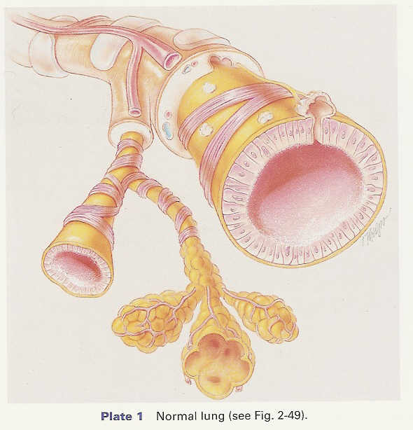
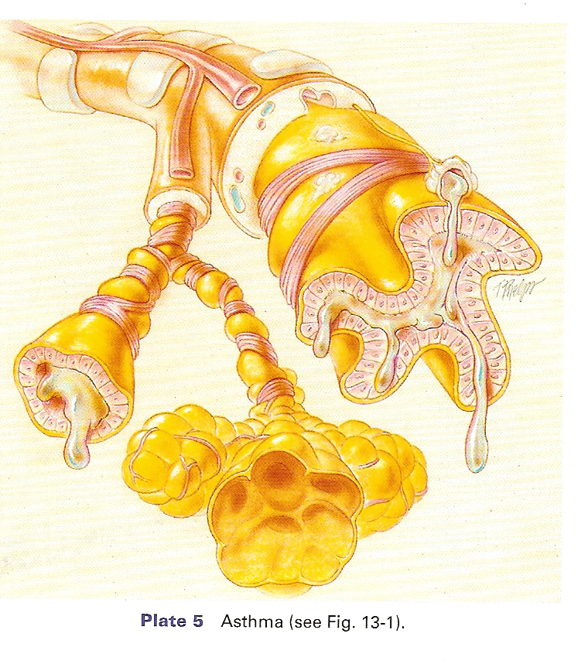
What we already know…
Asthma is a “chronic inflammatory disease”

Slide 9
ANATOMIC CHANGES:
Airway & mucosal inflammation
Smooth muscle constriction
Smooth muscle hypertrophy*
Goblet cell increase
Mucus gland enlargement
Ciliary damage
Air trapping
SIGNS & SYMPTOMS:
Inspection:
Tachypnea
Prolonged exhalation
Tachycardia
Hypertension
Pulsus Paradoxus
Cyanosis
Cough & sputum production
SIGNS & SYMPTOMS:
Inspection:
Barrel chest
Accessory muscle use & tripod use
Pursed lip breathing
Retractions
Palpation
Decreased tactile fremitus
Rhonchial fremitus
Percussion
Hyperresonant percussion
Auscultation
Wheezing & rhonchi
Diminished breath, heart & vocal sounds (fremitus)

Slide 10
DIAGNOSTICS
Abnormal PFT
Decreased FVC, FEV₁ & flows
Increased RV & RV/TLC ratio
Lab value changes
Increase eosinophils
Charot-Leyden crystals (found in sputum from eosinophil breakdown)
Kirschman spirals
(spiral shaped mucus plugs)
Elevated IgE levels (extrinsic)
DIAGNOSTICS
Abnormal ABG
Initially: Acute alveolar hyperventilation with hypoxemia
Severe: Acute ventilatory failure with hypoxemia
Abnormal x-ray *
Flattened diaphragms
Hyperlucent lung fields
Long narrow heart
Flattened ribs
Increased retrosternal air space
Atelectasis (from mucus plugging)

Slide 11
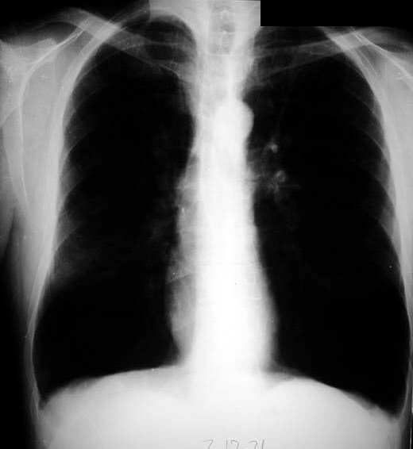
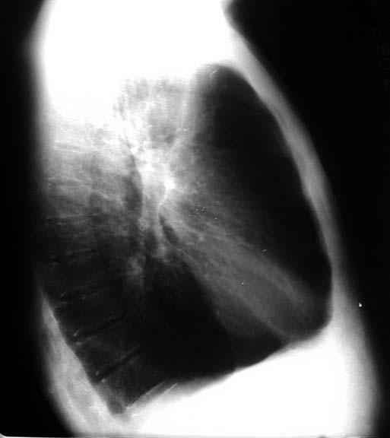
Flattened diaphragms
Hyperlucent lung fields
Long narrow heart
Flattened ribs
Increased retrosternal air space

Slide 12
Goal of Therapy in ASTHMA
Empty the lungs!
… just like Emphysema

Slide 13
MODULE C Major Topics
Asthma Summary
Non-invasive strategies
Invasive strategies to improve ventilation
Scenario

Slide 14
Non-invasive Management Strategies

Slide 15
Non-invasive Management Strategies
Short term Oxygen therapy.
Low (nasal cannula) & high flow (AEM & Vapotherm).
Patient positioning (head up, tri-pod).
Aerosol therapy.
Beta 2 agonists, anticholinergics, methylxanthines, inhaled & IV steroids
Leukotriene inhibitors.
Heli-ox via non-rebreather mask.
IV Magnesium Sulfate.
Bronchial hygiene
PEP Therapy, Acapella
Vaccines & antibiotics (as needed)
NIPPV via mouthpiece/mask(with aerosol therapy).

Slide 16
Magnesium sulfate (MgSO₄)
Considered as an adjunct therapy for severe and life-threatening asthma exacerbation.
Theoretically it can induce bronchial smooth muscle relaxation in a dose-dependent manner by inhibiting…
calcium influx into the cytosol (the water-soluble components of cell cytoplasm, constituting the fluid portion that remains after removal of the organelles and other intracellular structures)
histamine release from mast cells
acetylcholine release from cholinergic nerve endings
It also may increase the bronchodilator effect of β₂-agonist by increasing the receptor affinity.

Slide 18
MODULE C Major Topics
Asthma Summary
Non-invasive strategies
Invasive strategies to improve ventilation
Scenario

Slide 19
Invasive Management Strategies
Proper Ventilator Management
Therapeutics
Pharmacology agents in MV
Permissive Hypercapnea
Heli-ox
Bronchial Thermoplasty

Slide 20
Proper Ventilator Management
Breath Type (volume or pressure)
Mode
Adjust tidal volume (low 5 – 8 mL/kg IBW or lower).
Reduce alveolar deadspace (air trapping).
Reduce mechanical deadspace.
Correct for circuit loss.
Adjust rate (</= 8 bpm).
Eliminate auto-PEEP.
Watch patient synchrony.
Allow for spontaneous breathing.

Slide 21
Invasive Management Strategies
Proper Ventilator Management
Therapeutics
Pharmacology agents in MV
Permissive Hypercapnea
Heli-ox
Bronchial Thermoplasty

Slide 22
Therapeutics
Aerosol therapy
Steroid use
Bronchial hygiene

Slide 23
Aerosol Therapy
Deposition
Dose
Spontaneous breathing
achieve 10 – 14% deposition
Ventilator patient
achieve 1.0 – 15.3% deposition
Why the great variation in dose delivery with the ventilated patient?

Slide 24
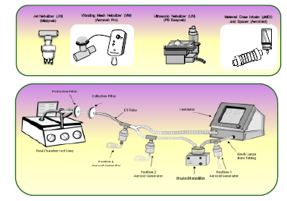
We can’t agree on where, which or how.

Slide 25
Methods of administering medication to improve ventilation
Things to consider:
What is the size of the patient?
What type of ventilator or O2 device is in use?
What type of humidification?
What type of aerosol generator?
Is bias flow present?
Is SVN flow intermittent or continuous?

Slide 26
What does the latest evidence say???

Slide 27
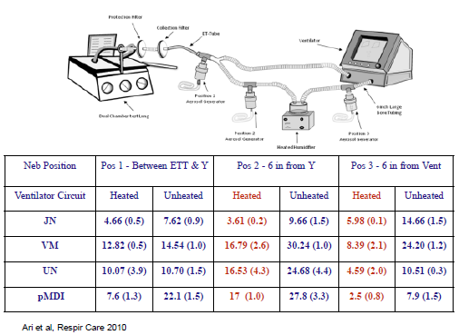
Ventilator without bias flow for flow triggering

Slide 28
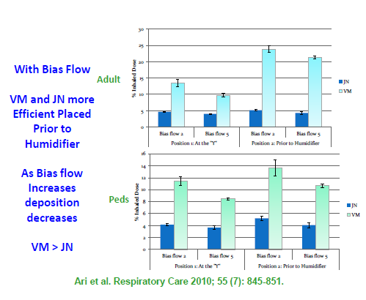

Slide 29
The Aeroneb Solo performance was 5-6 times superior to small volume nebulizers and outperformed all others at all locations.

Slide 30
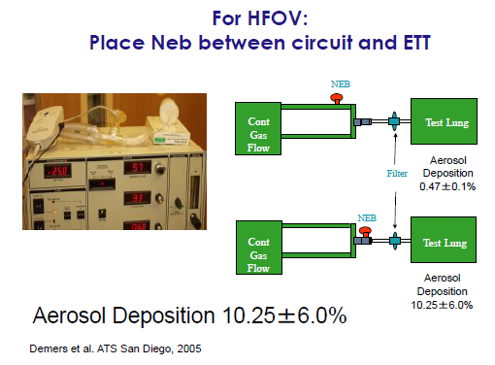
High Frequency Ventilation

Slide 31
High Flow Nasal Cannula
Aeroneb

Slide 32
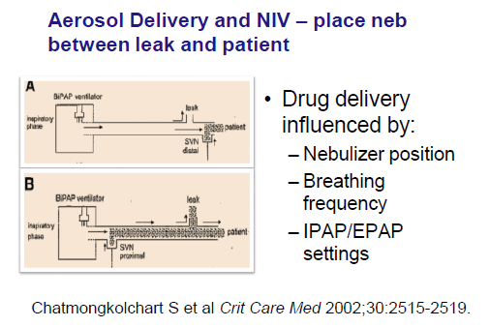
Non-invasive ventilation

Slide 33
Which nebulizer and how much drug to use?
Different Equipment:
In all studies, the Vibrating Mesh and MDI with spacer delivered more than twice as much medication as the SVN
2. Different drugs:

Slide 34
SUMMARY
Placement for adults & peds on vent:
MDI or SVN intermittent on insp. side of wye.
SVN continuous or intermittent – always at ventilator.
Continuous flow = reservoir.
Cleaner (no secretions nebulized).
Aeroneb
Bias flow - At vent or humidifier.
No bias flow – place on insp. side of wye

Slide 35
SUMMARY
Placement for adults & peds :
HFOV - Place all equipment between wye & ETT
HFNC -
MDI at nose
Jet neb & Aeroneb – before humidifier
NIV - MDI, Jet neb & Aeroneb – at mask

Slide 36
MSRC 2014 - Fink
Placement for neonates on any type of ventilation (conventional or HFOV):
MDI , Jet neb & Aeroneb – at patient airway between ET & Wye connector.

Slide 37
Other Things to Improve Aerosol Deposition
Mode
Encourage spontaneous breathing.
Tidal Volume
Increase as much as possible (>500cc).
Use of sigh is acceptable.
Respiratory Rate
Decrease as much as possible.
Duty Cycle
Increase inspiratory time as much as possible.
Use of a plateau or inspiratory hold is controversial.
Actuate during early insp. NOT end exhalation.
Place & Use Equipment Properly
MDI, Chamber, Spacer, Nebulizer, Gas Flow...

Slide 38
How do I know when I get the desired effect?
Dose Response Therapy
Increasing the dosage to achieve the desired or optimal effect.
Monitor for side effects.
Monitor for hypokalemia & dysrhythmias.

Slide 39
Assessing Response
Graphic Assessment
Pressure – Time Curve
Peak – plateau pressure difference*
Airway resistance measurement
Auto-PEEP Maneuver

Slide 40
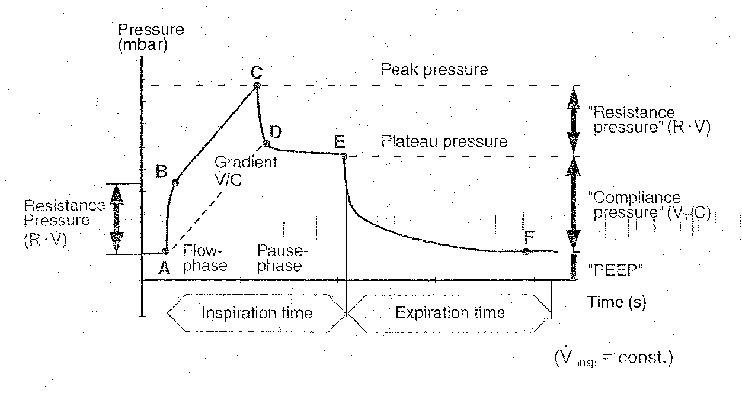
Compliance & Resistance

Slide 41
Assessing Response
Graphic Assessment
Flow-Time Curve (or flow-volume loop)
Expiratory flow tracing
Auto-PEEP maneuver

Slide 42
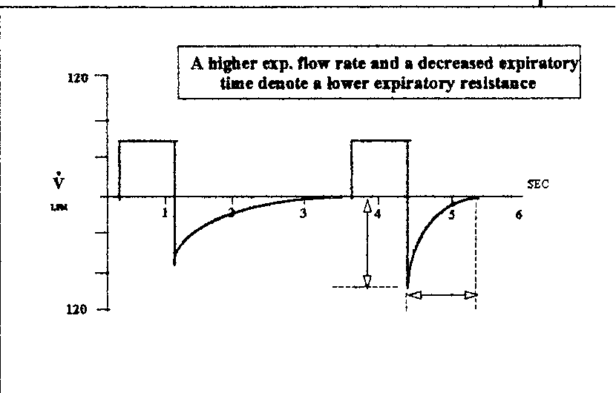

Slide 43
Assessing Response
Patient Assessment
Breath sounds
Patient WOB
Vital signs
SpO₂

Slide 44
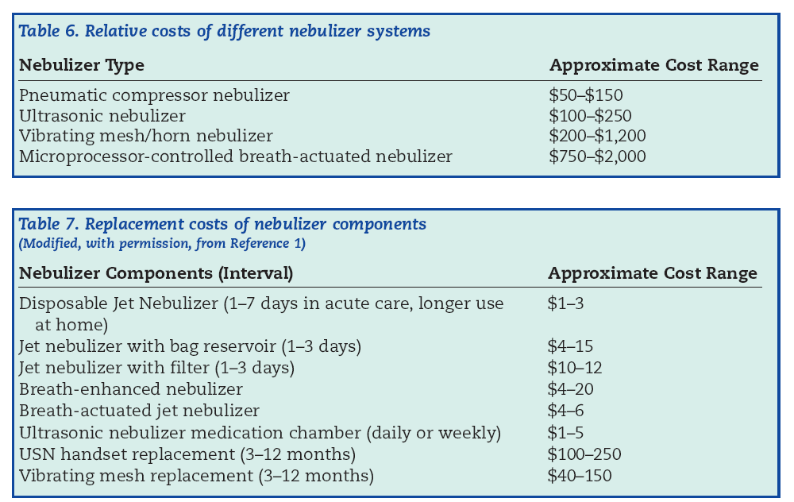
Consider Costs of Different Nebulizers

Slide 45
Using an MDI

Slide 46
Advantages associated with MDI
Faster & Possibly Cheaper (labor time).
As good or better than SVN when using spacer or VHC.
Does not add any flow so it does not alter.
Trigger
Vt.
PIP
Flow
FIO2
Alarm function
Does not contaminate & obstruct expiratory filter.

Slide 47
Using an MDI
with any humidification system
on adult or pediatric
conventional ventilation.

Slide 48
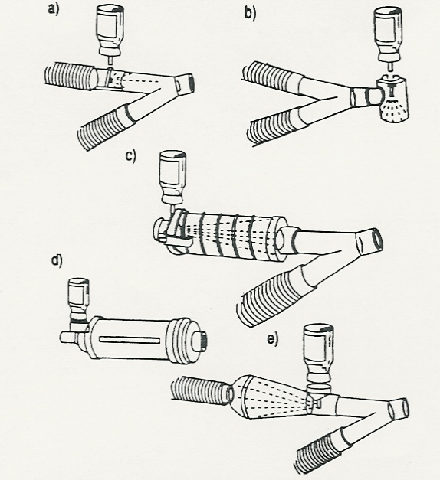
You must use a Large-volume spacers.
*improve inhaled aerosol deposition 4 – 6 fold over MDI adapters.

Slide 49
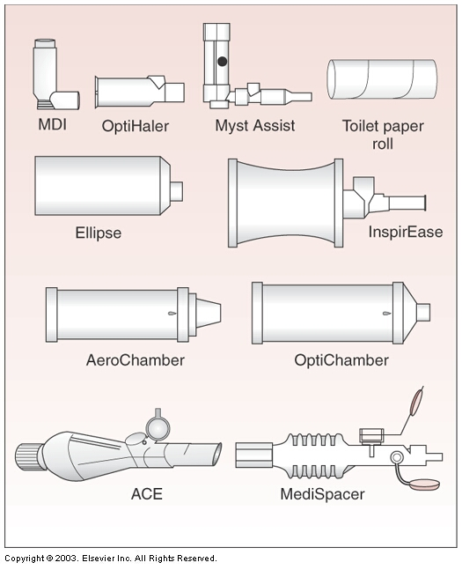
Large-volume spacers
*improve inhaled aerosol deposition 4 – 6 fold over MDI adapters.

Slide 50
HME or HME Booster
Placed spacer 2 – 6 inches from wye on inspiratory side.
Spacer can be left in place.
Remove HME or HME Booster before therapy and replace afterwards.

Slide 51
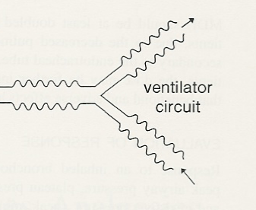
ET tube
Remove HME
HME
MDI
Spacer
Proper placement of MDI Spacer when using any humidifier
Leave MDI spacer in inspiratory line & remove HME for treatment.

Slide 52
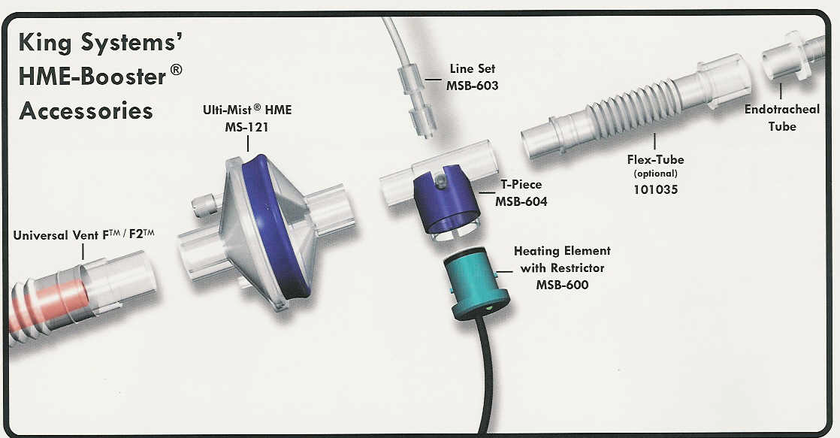
Place on insp. side of wye

Slide 53
HME Bypass System
Good way to prevent derecruitment

Slide 54
Bypass HMEs
Placed spacer 2 – 6 inches from wye on inspiratory side.
Spacer can be left in place.
Do not need to remove or replace anything.
Adjust to “aerosol mode” for therapy and return to “HME mode” afterwards.

Slide 55
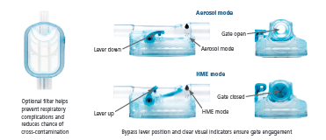
Lever down = aerosol mode
Lever up = HME Mode

Slide 56
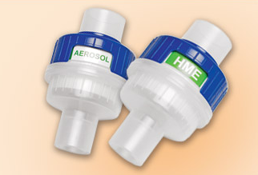
Gibeck Humid-Flo 72-hour passive humidification
http://www.teleflex.com/en/usa/productAreas/respiratory/productGroups/ventilationManagement/products/gibeck-humid-flo/components/index.html#video-player

Slide 57
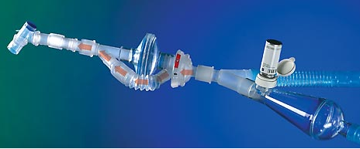
HME Bypass System
Circuvent

Slide 58
Heated Water Bath (active)
Placed spacer 2 – 6 inches from wye on inspiratory side.
Spacer can be left in place.
Do not need to remove or replace anything.

Slide 59
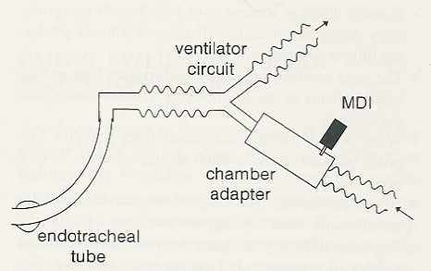
Good way to prevent derecruitment
Heated Humidifier
Proper placement of MDI Spacer when using Heated Humidifier
Leave inline at inspiratory line before wye connector.
No need to break circuit

Slide 60
Problems associated with MDI
Some organizations do not use the proper size spacers.
Should be the size of toilet paper roll.
Much more efficient than small adapters.
Do not use elbows or closed suction adapters.
Some MDIs are not ventilator friendly (DPI, Respimat).
MDIs have become more expensive especially when used as single patient use canisters.
You may need to open circuit to give therapy. (remove HME)…
Increased risk of VAP.
Increased risk of derecruitment.

Slide 61
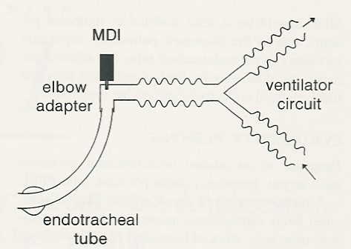
Do not use MDI here for adults or peds – only neonates.
HME/filter
Aerosol particles will impact against endotracheal tube. For neonates - use proper size spacer.

Slide 62
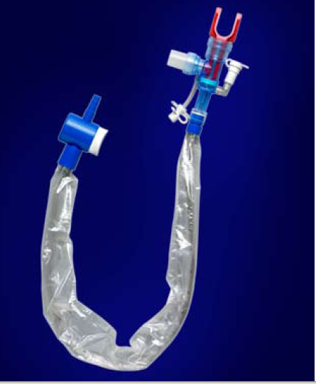
Do not use MDI port on closed suction system.
AARC CPG State:
7.6.1.2 Small-gauge adapters with closed suction devices. No published data support the use of these adapters.

Slide 63
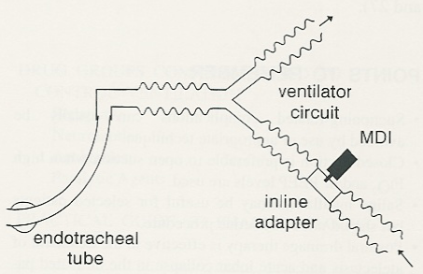
HME/filter
Do not use small adapters – use proper size spacer for adults and peds.

Slide 64
Using a Small Volume Nebulizer (SVN).

Slide 65
Using an SVN
with any humidification system
on adult or pediatric
conventional ventilation.

Slide 66
Small Volume Nebulizers
Intermittent flow or continuous flow.
Placed SVN 3 – 6 inches from ventilator outlet.
Consider placing a filter in expiratory line if using continuous flow.
Remove HME for therapy.

Slide 67
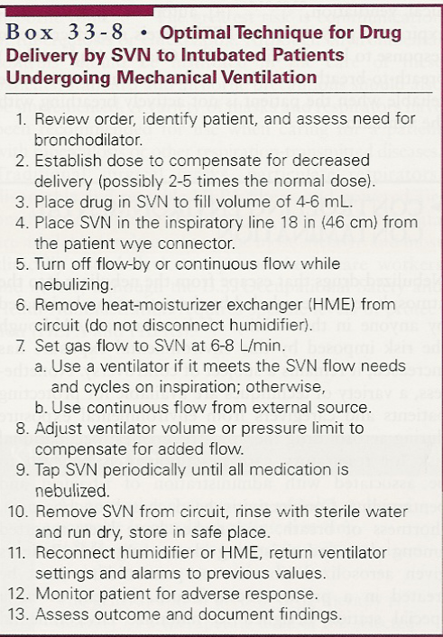
#4 NEW GUIDELINE: 3 – 6 inched from ventilator outlet.

Slide 68
SVN in inspiratory line
Remove during tx.
F
HME
SVN
Proper placement of nebulizer
Remove HME and add SVN & possibly Filter (F)

Slide 69
Problems associated with SVN
May need to open circuit for therapy.
Remove and replace HME.
Place & remove SVN.
New spring loaded SVN adapters can be left in line.
Takes a significant amount of time (labor costs).

Slide 70
Problems associated with SVN
If using a continuous flow:
Difficulty triggering (may need to increase rate).
Change in FiO₂
Errors in flow & volume measurement.
Increase in tidal volume.
Increased pressures.
Alarm malfunction.
“Gummed up expiratory parts (filters).
Loss (waste) of medication during exhalation.

Slide 71
Using a Vibrating Mesh Nebulizer
with any humidification system
on adult or pediatric
conventional ventilation.

Slide 72
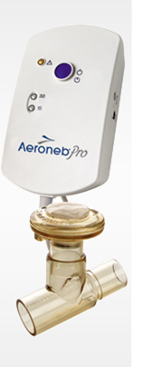
Aeroneb Pro Nebulizer
The Aeroneb Pro overcomes the limitations posed by current methods of in-line aerosolization because it:
increases deposition of drug in the lungs.
eliminates ventilator interruption.
does not interference with ventilator performance.
Does not cause heat degradation of medication.

Slide 73
Aeroneb Pro Nebulizer
Utilizing Aerogen’s OnQ™ Aerosol Generator, the Aeroneb Pro produces a fine particle, low velocity aerosol without environmentally unfriendly propellants, inefficient compressors or costly ultrasonic elements.
The Aeroneb Pro overcomes the issue of poor aerosol delivery during mechanical ventilation, depositing up to four times more medication through an endotracheal tube (in vitro) during mechanical ventilation than small volume nebulizers (SVNs).

Slide 74
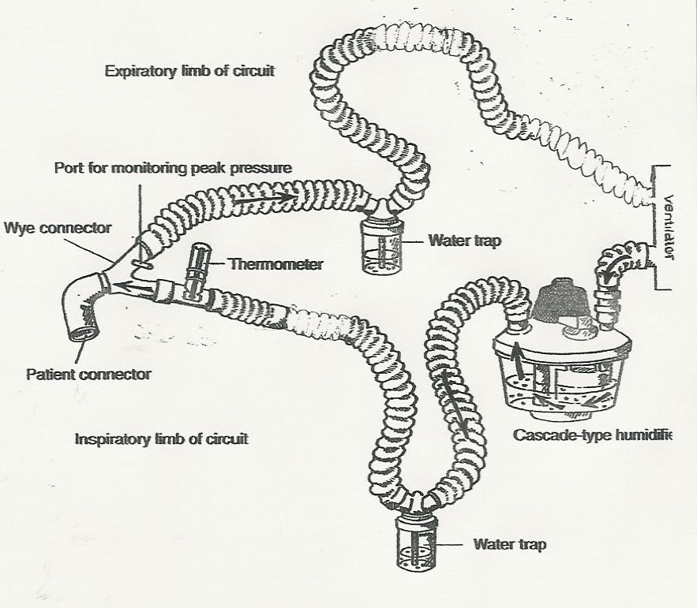
Proper placement of Vibrating Mesh Nebulizer such as AeroNeb Pro
VM
VM

Slide 75
LET’S LOOK AT NEXT PERFORMANCE EVALUATION

Slide 76
Invasive Management Strategies
Proper Ventilator Management
Therapeutics
Pharmacology agents in MV
Permissive Hypercapnea
Heli-ox
Bronchial Thermoplasty

Slide 77
Therapeutics
Aerosol therapy
Steroid use
Bronchial hygiene

Slide 78
Steroids
Systemic corticosteroids (Solu-Medrol)
should be used cautiously in patients receiving steroidal based neuromuscular blocking agents (vercuronium bromide & pancuronium bromide) because of the potential of prolonged blockade.
Prolonged paralysis
can hinder weaning.
Inhibit ability to ambulate for weeks or months.
Steroids & paralytics – bad combination.

Slide 79
Bronchial Hygiene
Hydration
Suctioning
Other methods as indicated

Slide 80
Invasive Management Strategies
Proper Ventilator Management
Therapeutics
Pharmacology agents in MV
Permissive Hypercapnea
Heli-ox
Bronchial Thermoplasty

Slide 81
Pharmacology agents in MV
Pilbeam - Chapter 15:
Sedatives , Analgesics and Paralytics

Slide 82
Sedatives & Analgesics
Uses:
Anxiety
Agitation
Promote sleep
Delirium
Pain
Types:
Benzodiazepines (valium, versed, ativan)
Analgesics (opiods, morphine, fentanyl)
Neuroleptics (haldol)
Anesthetic Agents (propofol- diprivan)

Slide 83
Levels of Sedation
Minimal
responds to verbal commands.
Moderate
requires more than verbal stimulation to respond
conscious sedation.
Deep
breathing may be affected.
Anesthesia
usually unresponsive & ventilated.

Slide 84
Sedatives (Benzodiazepines -valium, versed, ativan)
Indications:
Reduce anxiety (anxiolysis)
Provide amnesia (strong hypnotic)
Induce sleep
Improve tolerance of mechanical vent.
Facilitate invasive procedures
Decrease oxygen consumption
Protect patient from self-injury

Slide 85
Adverse reactions
Usual side effects:
Confusion, Weakness, Dizziness, Drowsiness, Ataxia, Syncope, Vertigo, Amnesia
Unusual side effects
CNS stimulation, restlessness, mania, euphoria, rage, sleep disorder
Withdrawal side effects:
Severe anxiety, tachycardia, diaphoresis, hypertension, seizures…)
Respiratory side effects:
Depression, apnea
Cardiovascular side effects:
Decreases SV, CO, MAP, BP, SVR

Slide 86
Narcotic analgesics (opioids - morphine, fentanyl)
Pain control for ICU patients is often inadequate.
Narcotic analgesics are used to control pain, allow early mobilization and decrease hospital stay.

Slide 87
Narcotic analgesics
Agonists (morphine, codeine, meperidine or demerol and fentanyl)
Most commonly used
Antagonist (naloxone or Narcan)
Used to reverse narcotic OD

Slide 88
Adverse effects
CNS – sedation, respiratory depression and atelectasis
Muscle groups - muscle twitching (myoclonus), convulsions, chest wall rigidity
CV – vasodilation, vagal bradycardia, hypotension
GI – delayed GI emptying, constipation, nausea
Others – contraction of pupils, altered levels of stress hormone, allergic reactions

Slide 89
Narcotic analgesics considerations
Tolerance – need to increase dosage to obtain effective pain relief.
Physical dependence – evidence of withdrawal syndrome (irritability, joint pain, chills, hot flashes, anxiety, nausea, vomiting, lacrimation, rhinorrhea, diaphoresis, abdominal cramps, diarrhea
Psychological dependence – behavior of drug seeking, preoccupation with obtaining and using, drug use for other than pain (euphoria).

Slide 90
Neuroleptics (haldol)
Used for extreme agitation and delirium
disorganized thinking
unnecessary motor activity
Whenever delirium is present, the route cause should be investigated

Slide 91
Anesthetics – (propofol)
With anesthesia the patient is unresponsive and usually ventilated
Example:
Diprivan
Produces and maintains anesthesia
Provides sedation in ventilator patients
Does not provide analgesia (use pain meds)
Adverse effects
Apnea, bradycardia, laryngospasm, bronchospasm, coughing, dyspnea, hypotension, burning or pain at infusion site, discolored urine
Monitoring in OR with Bispectral Index (BIS)

Slide 92
Paralytics
Provide temporary paralysis of skeletal muscles.
Used in combination with sedative drugs and narcotic analgesics because perception & pain still exist. (awake & paralyzed)
Indications:
Intubation
Laryngeal spasm
Surgery
Mechanical ventilation

Slide 93
Use in mechanical ventilation
Reduced combativeness & agitation.
Respiratory muscle relaxation.
Increased chest wall compliance.
Synchronization during unnatural modes.
Prevention of hypoxemia due to increased WOB.
Decreased ICP from excessive movement.

Slide 94
Neuromuscular blocking agents
Depolarizing – prolongs the depolarization phase of muscle contraction. Muscle thinks ACh is present. Short acting
Succinylcholine (Anectine, Quelicin)
Nondepolarizing – competes with acetylcholine (ACh) for the sites at the motor end plated, thus blocking the normal action of acetylcholine preventing depolarization. Long acting.
Turbocurarine chloride (Tubarine)
Pancuronium bromide (Pavulon) Depolarizing Agents

Slide 95
Adverse effects
Apnea (set alarms carefully)
Loss of cough
Poor neurologic assessment
Emotional trauma (sedation needed)
Disuse atrophy
Pressure sores
Increased iatrogenic morbidity & mortality
Histamine release
CV side effects (tachy, brady, dysrhythmia...)

Slide 96
Evaluation of NM blockade
Train-of-Four
Peripheral nerve stimulator.
Measures muscle twitch in response to stimulus.
Spontaneous muscle effort (> 5 seconds)
Open eyes
Head lift
Protrude tongue
Hand grip
Ventilation parameters
MIP & VC
ABG

Slide 97
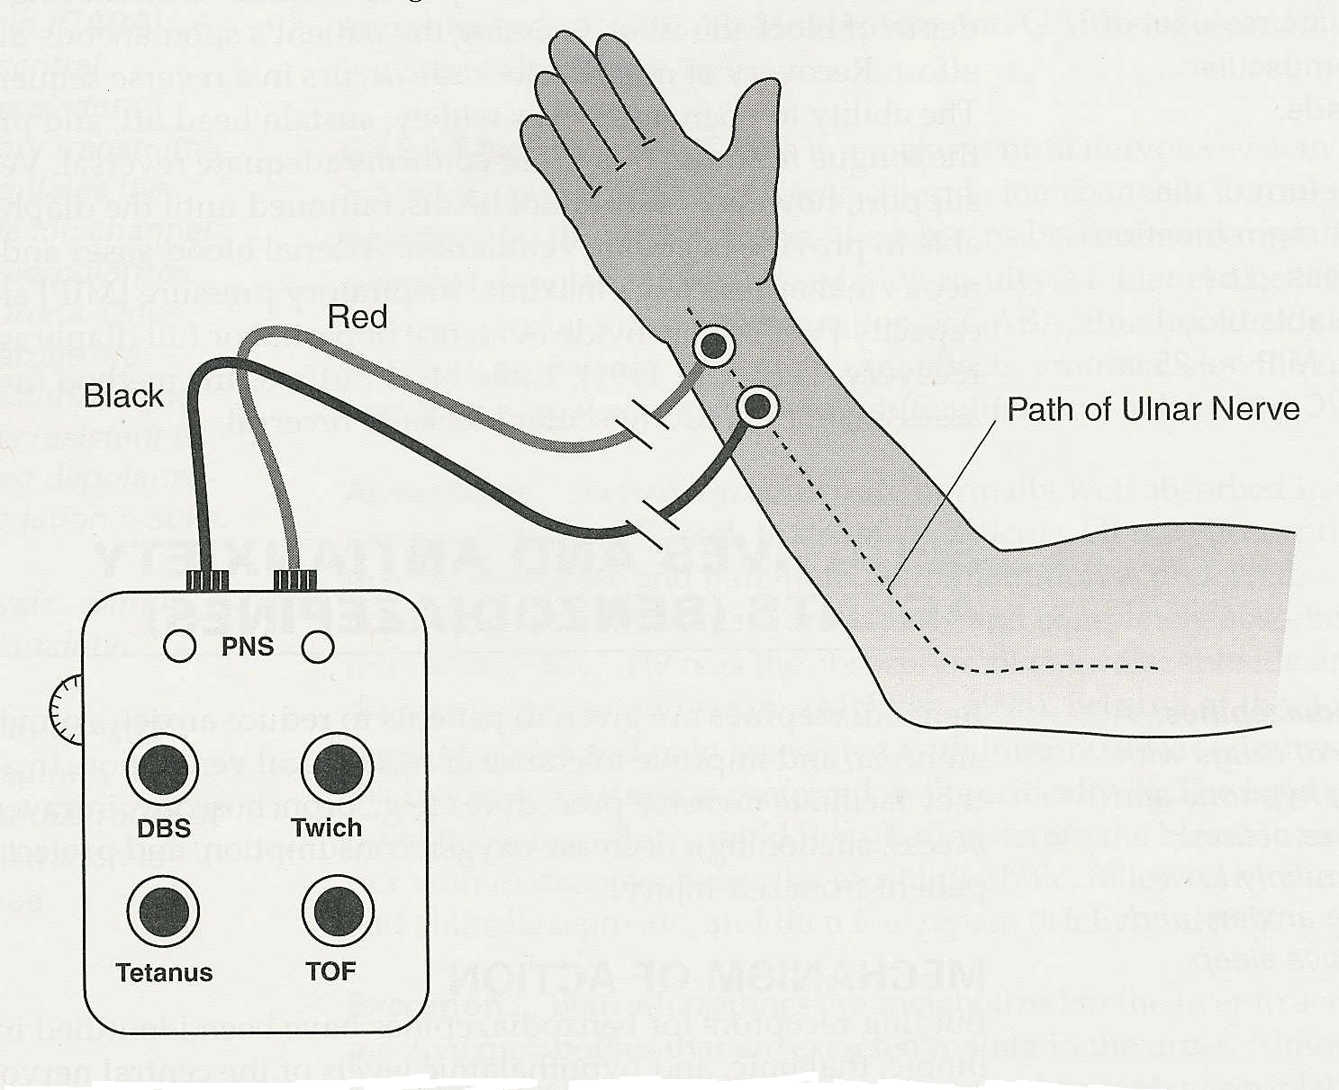
Train-of four (TOF) monitoring

Slide 98
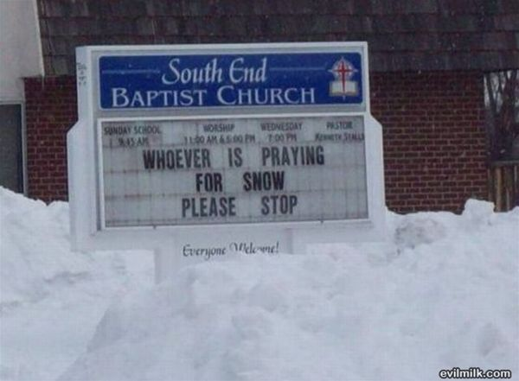

Slide 99
Invasive Management Strategies
Proper Ventilator Management
Therapeutics
Pharmacology agents in MV
Permissive Hypercapnea
Heli-ox
Bronchial Thermoplasty

Slide 100
Permissive Hypercapnia
Strategy to minimize the occurrence of ventilator-related lung injuries caused by positive pressure ventilation.
Barotrauma & pneumothorax is not uncommon in these patients
Accepting higher than normal PaCO2 so lung can be protected.
Hypoventilation usually results in a decreased pH (some as low as 7.10 but most >/= 7.20).
Often used for status asthmaticus and ARDS patients.

Slide 101
Permissive Hypercapnia
PROCESS:
Slow reduction of tidal volume to levels as low as 4 - 6 mL/kg IBW.
Lower tidal volume slowly at 50 ml Q 20 – 30 min over a 12 - 24 hour period.
Lower tidal volume or lower peak pressures.
Keep Plateau pressures </= 30 cm H₂O.

Slide 102
Permissive Hypercapnia
PROCESS:
Example of one guideline:
PaCO₂ allowed to rise up to 80 mmHg.
Allow PaCO₂ to increase no more than 10 mmHg per hour.
pH usually kept >/= 7.20 with buffers.

Slide 103
Permissive Hypercapnia (continued)
Attempt to normalize pH with buffers
Bicarbonate (for resp. acidosis???)
HCO₃⁻ + H⁺ = H₂CO₃ = CO₂ + H2O
Excreted by lungs
Buffer effect greater than CO₂ production effect
Tris-hydroxymethyl-aminomethane (THAM)
Binds with H+ and excreted by kidneys

Slide 104
Permissive Hypercapnia (continued)
Complications of acidosis:
CNS dysfunction
Intracranial hypertension
Neuromuscular weakness
Cardiovascular instability
Increase pulmonary vascular resistance
Respiratory distress
Electrolyte imbalance

Slide 105
Permissive Hypercapnia (continued)
Complications of low tidal volume &/or low PIP
Decreased MAP & oxygenation
Atelectasis
Patient discomfort
Patient may require increased FiO₂, increased levels of PEEP and sedation

Slide 106
3. Invasive Management Strategies
Proper Ventilator Management
Therapeutics
Pharmacology agents in MV
Permissive Hypercapnea
Heli-ox
Bronchial Thermoplasty

Slide 107
Heli-ox Therapy
Low-density breathing gas mixture.
Concentrations:
60%/40% or 70%/30% or 80%/20%
May reduce airway resistance.
1/3 density of air.
Slight increase in viscosity.
Decreased turbulence in flow.
Decreased work of breathing.

Slide 108
Heli-ox Therapy
Used to buy time while underlying upper airway problem resolves:
Post extubation stridor
Tracheobronchitis
Croup
Tracheal stenosis
Extrinsic compression (tumor)
Angioedema
Vocal cord paralysis
Foreign body

Slide 109
Heli-ox Therapy
Used to buy time while underlying lower airway problem resolves:
Asthma
Bronchiolitis
COPD
Dyskinesia

Slide 110
Heli-ox Therapy
Has been used with spontaneous breathing asthmatic patients.
Decreased PaCO₂
Increased flow.
Decreased resp. muscle fatigue (decrease WOB).
Decreased pulsus paradoxus.
Has been used with intubated, mechanically ventilated asthmatic patients.
Decreased PaCO₂
Decreased ventilating pressures.
MDI recommended for aerosol therapy.

Slide 111
Heli-ox Therapy
Drawbacks:
Need special gas supply equipment.
Mixed gas cylinders recommended (2 – 6 per 24 hours)
He flowmeters & regulators recommended.
If O₂ flowmeter used a correction is made.
60%/40% (flow times 1.4)
70%/30% (flow times 1.6)
80%/20% (flow times 1.8)

Slide 112
Heli-ox Therapy
Drawbacks:
Need special delivery equipment
SPONTANEOUS: Well fitting non-rebreather.
VENTILATOR: Flow sensors and volumes inaccurate so recommend pressure ventilation (Servo best).

Slide 113
Heli-ox Therapy
Drawbacks:
Limitation on oxygen use up to 40%.
Expensive.
Potential for suffocation if using separate gas cylinders and oxygen source lost.
If used >24 hours it can cause hypothermia so warm gases to body temperature (He has high thermal conductivity).

Slide 114
Heli-ox Therapy
Drawbacks with Mechanical Ventilation.
Erroneous volume & flow measurements (low).
Heated wire flow measuring devices are not recommended (Drager).
Do not use Heliox with: NPB 840,
Good ventilators are Servo 900C, 300A, Servo i
Need active heated humidification with preferably heated wire.

Slide 115
Heli-ox Therapy
Drawbacks with Mechanical Ventilation.
Helium can interfere with:
Trigger & Cycling
Valve function & Gas mixing
Leak compensation
Monitors & Alarms (especially volume)
Pressure ventilation may be more appropriate.

Slide 116
Aptae’r Heliox Delivery System
Pressure support ventilator.
Works off pre-mixed heliox cylinders.
Has built in
Aeroneb nebulizer system
Rise time
E-sen%
Alarms

Slide 117
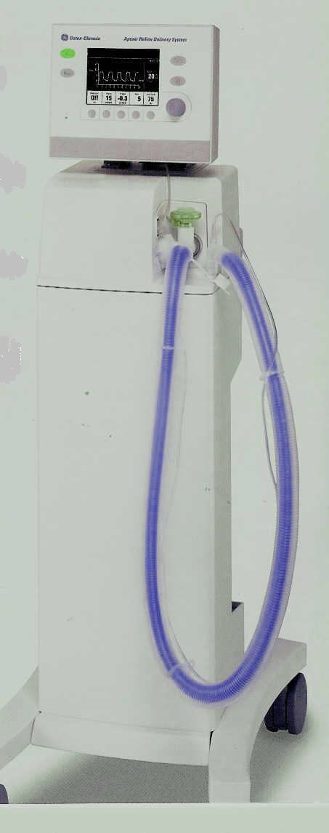
Aptae’r Heliox Delivery System

Slide 118
Invasive Management Strategies
Proper Ventilator Management
Therapeutics
Pharmacology agents in MV
Permissive Hypercapnea
Heli-ox
Bronchial Thermoplasty

Slide 119
Bronchial Thermoplasty
Radiofrequency ablation of airway smooth muscle for sustained treatment of asthma.
Non-drug option for treatment.
Sunnyvale, Calif.-based Asthmatx Inc. received U.S. Food and Drug Administration approval on the use of the Alair Bronchial Thermoplasty System for treatment of severe persistent asthma in patients 18 and older whose asthma isn’t well controlled with inhaled corticosteroids and long-acting beta agonists.
The system is the first device-based asthma treatment approved by the FDA

Slide 120
Bronchial Thermoplasty
Radiofrequency ablation (thinning) of airway smooth muscle for sustained treatment of asthma
For treatment of severe persistent asthma in patients 18 and older whose asthma isn’t well controlled with inhaled corticosteroids and long-acting beta agonists.
There is a sustained reduction in airway responsiveness to methacholine.

Slide 121
Bronchial Thermoplasty Treatment
The procedure is well tolerated.
The procedure requires only light anesthesia
It can be performed on an outpatient basis.
Three thirty-minute treatments usually takes care of all accessible airways.

Slide 122
Bronchial Thermoplasty Video
http://www.youtube.com/watch?v=m6WQLHTu53Y

Slide 123
Bronchial Thermoplasty Treatment
A small, flexible tube called a bronchoscope is inserted through the nose or mouth and guided into the lungs.
Once the bronchoscope is situated in the desired airway, a catheter is inserted through the bronchoscope.
The tip of the catheter is inflated until it touches the sides of the airway wall.
Radio frequency energy is then sent through the catheter, heating the smooth muscle walls of the airway to approximately 149° F.
This temperature is sufficient to thin the smooth airway wall muscles without scarring or damaging them.

Slide 124
Bronchial Thermoplasty
Two assumptions underlie the development of this procedure:
ASM is a vestigial tissue.
That treatment directed at ASM alone will provide sustained symptomatic and physiological improvement in asthmatic humans.

Slide 125
Bronchial Thermoplasty Treatment
During an asthma attack, the smooth muscles of the airways contract.
Because bronchial thermoplasty thins the muscle walls, they cannot narrow as much when irritants trigger asthma attacks, resulting in less symptoms and asthma relief.
Participants in the bronchial thermoplasty study received three thirty-minute thermoplasty treatments that treated all accessible airways.

Slide 126
MODULE C Major Topics
Asthma Summary
Non-invasive strategies
Invasive strategies to improve ventilation
Scenario

