Slide 1
RSPT 2335
Module A
AIRWAY MANAGEMENT
Part 2b
Tracheal Airways

Slide 2
Parts of Module A AIRWAY MANAGEMENT
Part 1 – Pharyngeal, Laryngeal & Esophageal Airways
Part 2 – Tracheal Airways
Part 3 – Airway Clearance
Part 4 - Advanced Airways
Part 5 - Airway Complications & Emergencies

Slide 3
Major Topics
Oral Intubation
Ventilator Associated Pneumonia
Alternative Airways & Accessories
Exchanges & Extubation
Tracheostomy Airway Insertion & Changes
Humidity & Oxygenation
Alternative Airways & Accessories
Laryngectomy
Communication Devices
Decannulation
Home care

Slide 4
Tracheostomy Airway Insertion and Changes

Slide 5
Terminology
Tracheotomy - Procedure used to form an opening in the trachea.
The opening is the tracheostomy.
A tube (a tracheostomy tube) is then inserted and usually sutured in place for approximately one week.

Slide 6
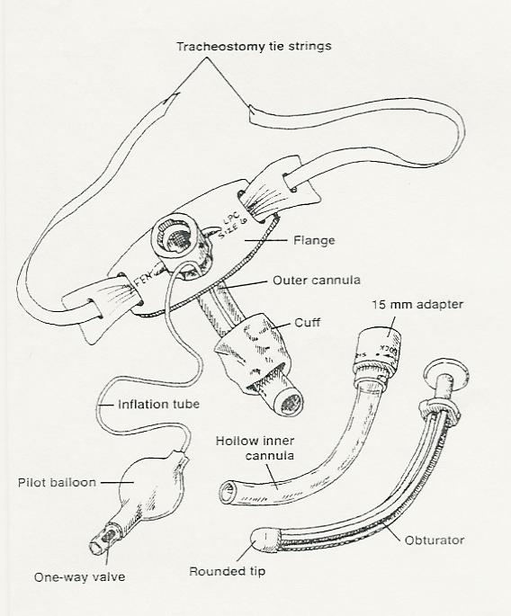
Shiley
Low pressure cuff (LPC) trach tube

Slide 7
Insertion
Surgical
Percutaneous

Slide 8
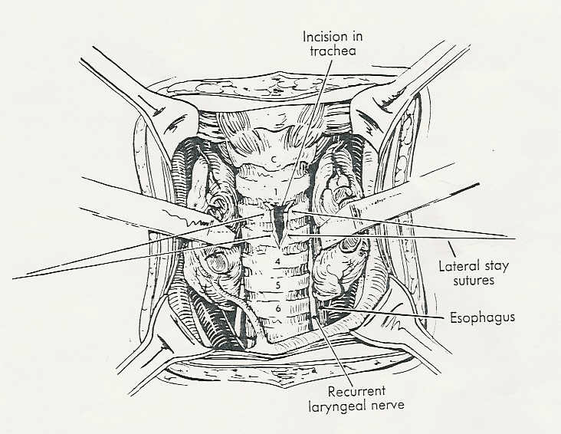
I. Surgical Tracheotomy
Usually cut through 1st, 2 or 3 cartilage
Surgical tracheostomy (5:36 min)
http://www.youtube.com/watch?v=Qc0tNXF8tU8

Slide 9
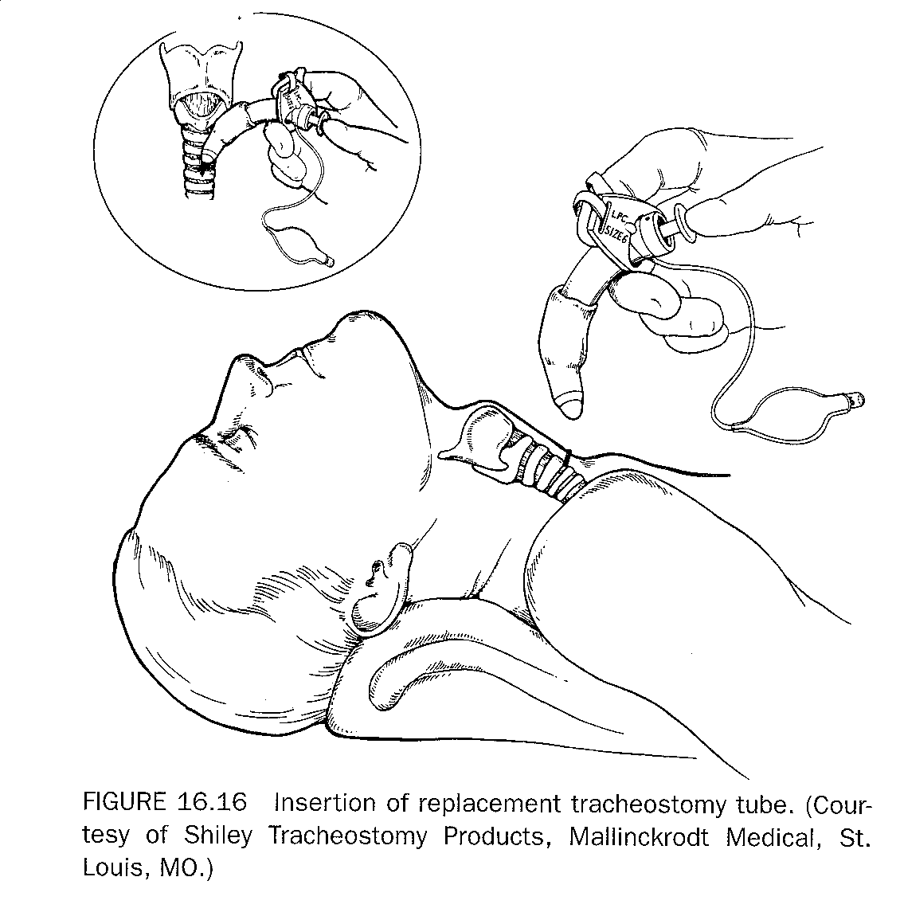
Lubricated tube with obturator is passed through the tracheal stoma (tracheotomy)

Slide 10
Percutaneous
Percutaneous dilational tracheostomy technique
Often done at bedside and assisted by therapist.
Lower cost with less complications.
Videotape: “Percutaneous Tracheostomy”
(9.5 minutes)
UltraPerc Tracheostomy with fiberoptic bronchoscopy (10:10 min)
http://video.smiths-medical.tv/services/player/bcpid784767379001?bckey=AQ~~,AAAAAEBRJ4w~,jnMMg6V5IsDF_lDBR0B4Jj6ceZ1yk6k2

Slide 11
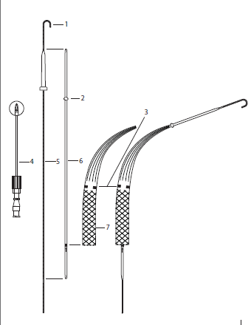
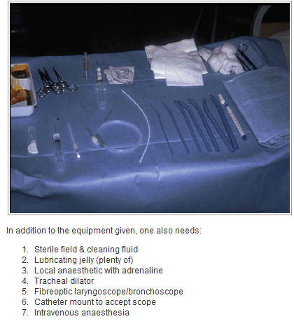
Percutaneous Tracheostomy

Slide 12
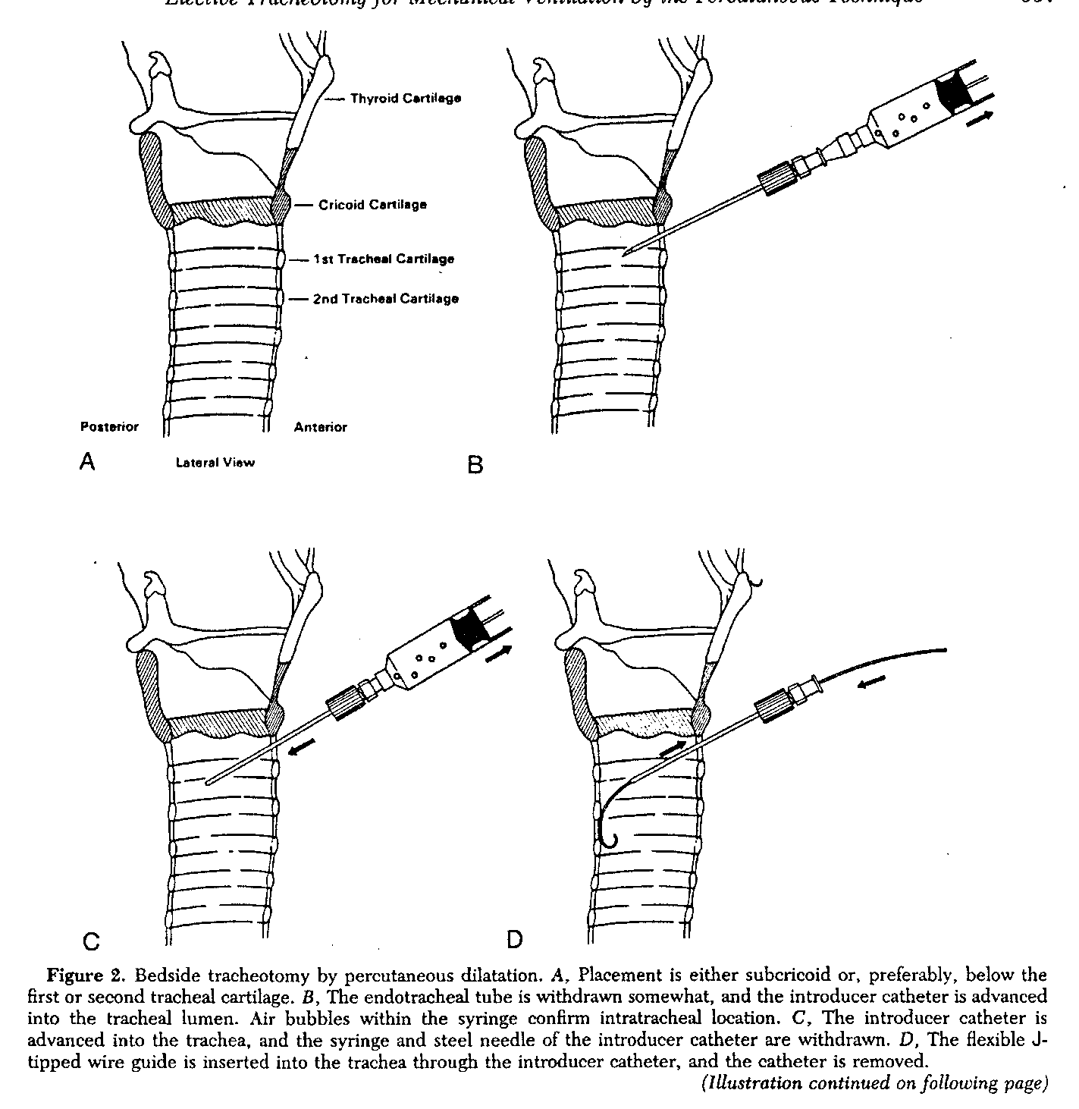
An over the needle catheter is first inserted into the space between the cricoid cartilage and tracheal ring #1 or between ring #1 & #2 and then a wire guide is inserted through the catheter.

Slide 13
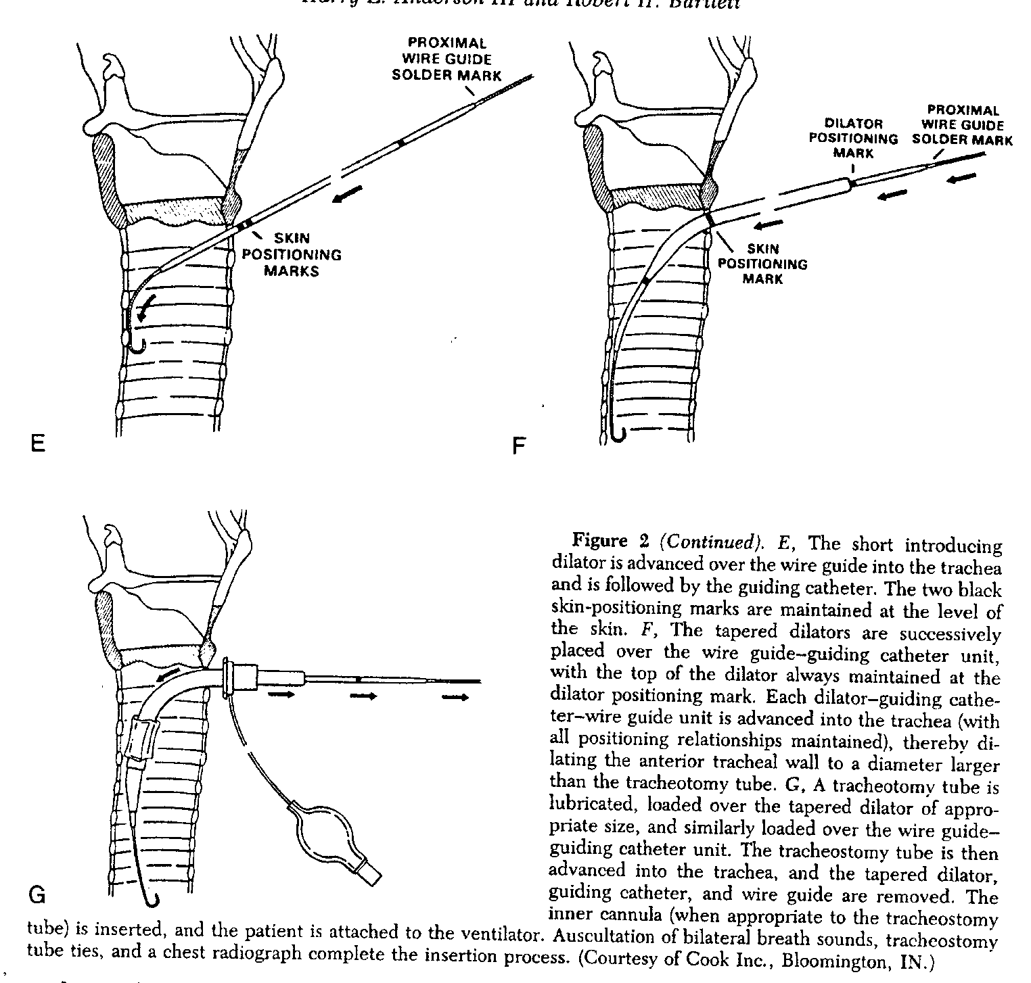
A short introducing dilator is placed over the wire guide followed by progressively larger dilators until the opening is large enough to accommodate the trach tube.

Slide 14
Tracheostomy Tube Position
Evaluate tube placement
Radiology: Tip of tube is located in approximately same place as ETT
2 -3 cm or 1 inch below the cords
2 - 7 cm above the carina at T2 - T4 (2 - 3 in.)
At the level of the aortic knob/notch
Mid trachea
Flange on tube should rest gently against skin and be tied securely. (Tubes do come in different lengths)

Slide 15
Changing the trach tube
Lab Chapter 23
Exercise 23.2.2– Tracheostomy Tube Insertion/Change

Slide 16
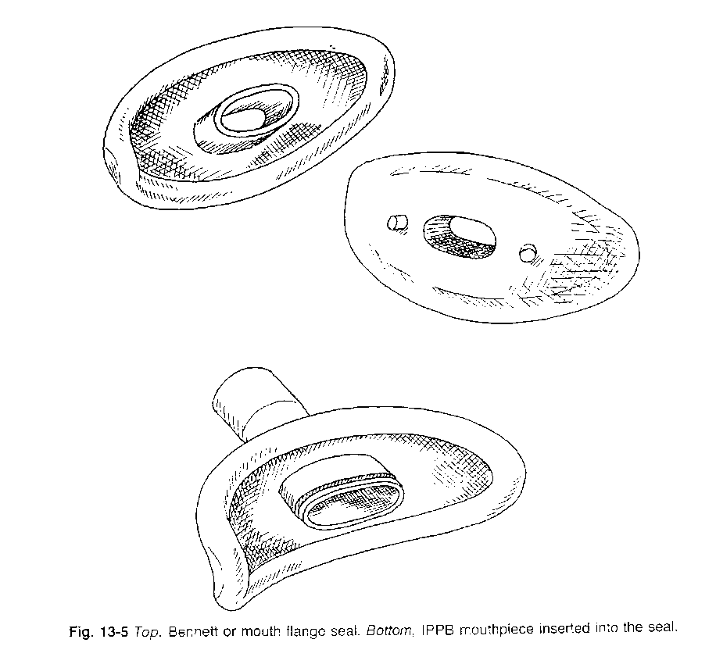
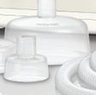
For a patient who loses their trach tube…
Place mouth seal on 15mm connector of resuscitation bag and use to seal over stoma
Use a neonatal resuscitation mask over stoma

Slide 17
Humidity and Oxygenation

Slide 18
Spontaneous Breathing Choices (non-vent)

Slide 19
Spontaneous Breathing Choices (non-vent)
Trach collar
cold or heated nebulizer
Stoma cover
HME
minimum of 30 mg/L humidity

Slide 20
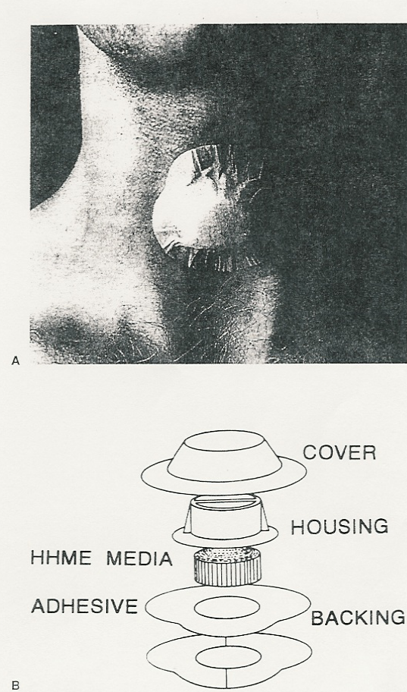
Stoma
Humidification & Protection

Slide 21
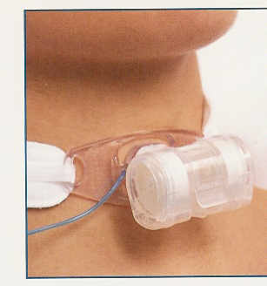
Trach HME

Slide 22
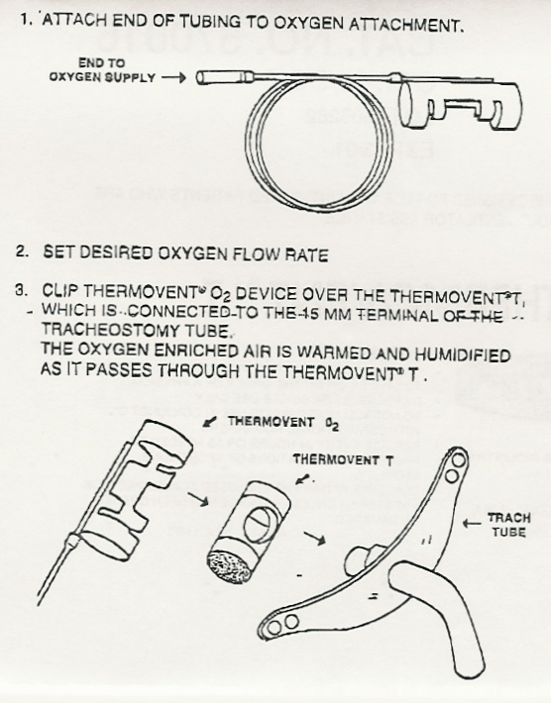
Thermovent O2
Humidification & Oxygenation of trach tubes
O2 flow Approx. %O2
2 52
4 57
6 59
8 60
10 60

Slide 23
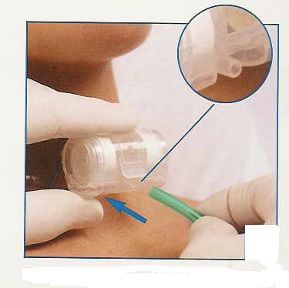
Portex Thermovent HME with O2

Slide 24
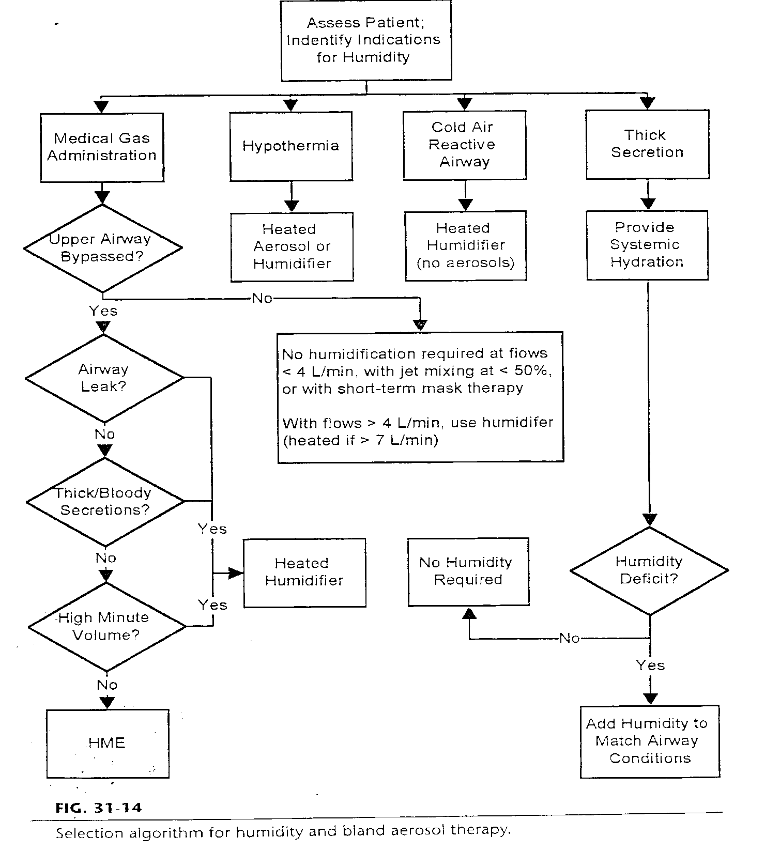
HME not used:
Dehydration
Hypothermia
Small VT (should be 3 x HME deadspace)
During aerosol tx

Slide 25
Ventilator Patient Choices:

Slide 26
Ventilator Patient Choices:
HME
minimum of 30 mg/L humidity
HME Booster
Heated water bath humidification

Slide 27
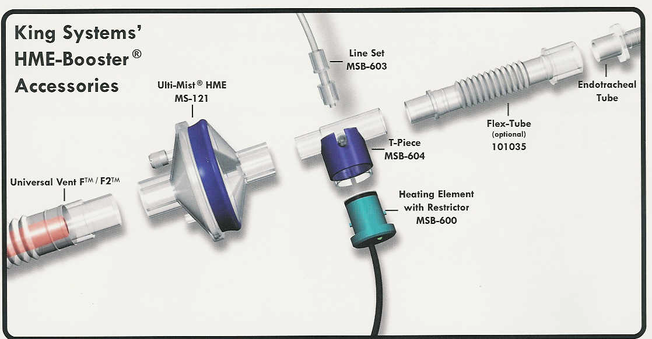

Slide 28
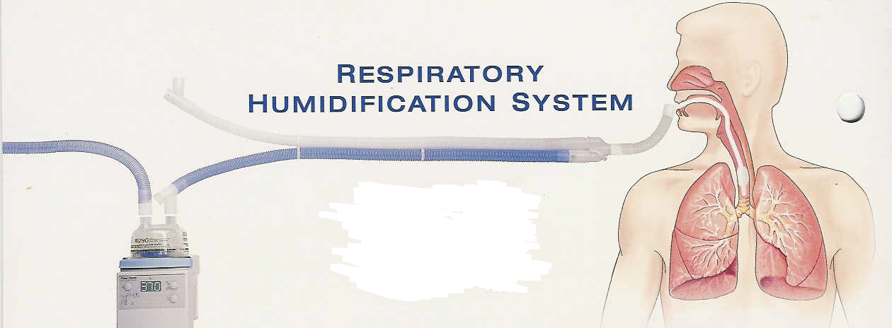
Fisher & Paykel
Heated Water Bath (HWB)

Slide 29
Alternative Airways and Accessories

Slide 30
Sizes
Sizes are very confusing on tracheostomy tubes.
Tube number does not correlate to internal diameter like ETT.
LOOK AT BOX FOR TUBE SIZES.
Evaluate proper suction catheter size very carefully.

Slide 31
Trach Tube Sizes
AGE
JACKSON, DCT, DFEN, LPC, FEN, CFS, CFN TUBE SIZES
OUTSIDE DIAMETER
(OD mm)
INSIDE DIAMETER
(ID mm)
Premature to newborn
000-00
4.5
2.5
Newborn to 6 months
0
5.0
5.0
6 - 18 months
1
5.5
3.5
18 months to 4 - 5 yrs
1 - 2
5.5 - 6.0
3.5 - 4.0
4 - 10 years
2 - 3
6.0 - 7.0
4.0 - 5.0
10 - 14 years
3 - 5
7.0 - 9.0
4.5 - 6.5
12 years to adult
6
7.0
12 years to adult
8
8.5
12 years to adult
10
9.0

Slide 32
SINGLE CANNULA TRACHS (SCT)
TRACH SIZE
INTERNAL DIAMETER
TRACH SIZE
INTERNAL DIAMETER
5.0
5.0 mm
8.0
8.0 mm
6.0
6.0 mm
9.0
9.0 mm
7.0
7.0 mm
10.0
10.0 mm
LARYNGECTOMY TUBES (LGT)
TRACH SIZE
INTERNAL DIAMETER
TRACH SIZE
INTERNAL DIAMETER
6.0
6.8 mm
10.0
9.1 mm
8.0
8.3 mm

Slide 33
Types of Tracheostomy Tubes
Low Pressure Cuff (LPC) reusable
Low Pressure Cuff (DCT) disposable
Cuffless (CFS)
Single cannula (SCT)
Extra Long (XLT)
Fenestrated (FEN) or (CFEN)
Jackson
Foam-cuff (Bivona or Kamen Wilkenson)
Water filled cuff (TTS)

Slide 34
Size & type
Shiley Low pressure cuff (LPC) trach tube
(reusable inner cannula)

Slide 35
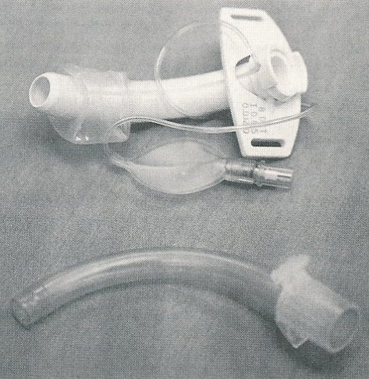
2. Shiley
Disposable inner cannula (DCT) trach tube

Slide 36
Trach Tubes
Cuffless (CFS)
No cuff
Used for non-ventilated patients
Used for patients without aspiration problems
Single cannula (SCT)
No inner cannula
More common in pediatrics
Allows for larger inner diameter and less airflow resistance

Slide 37
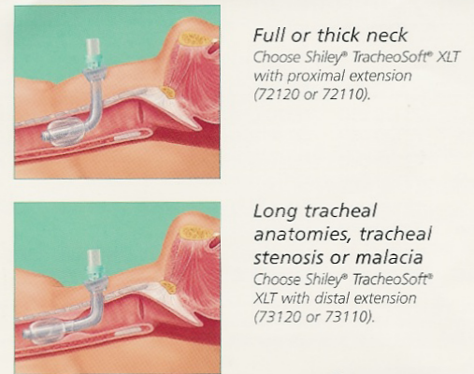
5. Special anatomical situations
Proximal extended length
Distal extended length

Slide 38
Wire Enforced Tubes
EXAMPLE: Bivona Mid-Range Aire-Cuff Hyperflex
Adjustable flange: Temporary tube for extended length
Adjustable length with locking flange
Sizes 6, 7, 8 and 9
Length 110 – 140 mm
Blue pilot valve = fill with air and measure cuff pressures

Slide 39
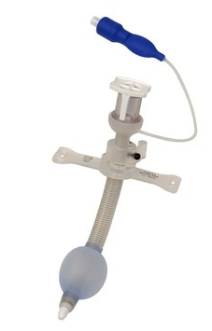
Bivona Mid-Range Aire-Cuff Hyperflex
Blue = air
Adjustable
Wire enforced = No MRI

Slide 40
6. Fenestrated Tubes
Tracheostomy tube with a hole in the posterior surface
Used to facilitate upper airway functions
Speech
Cough
Valsalva
Smell
Taste
blowing nose
Used to facilitate decannulation.

Slide 41
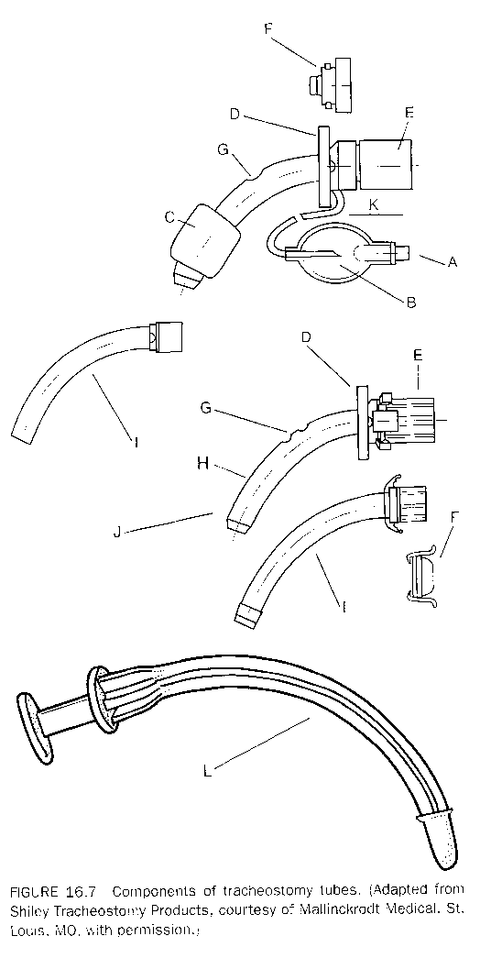
J
H
N
O
M

Slide 42
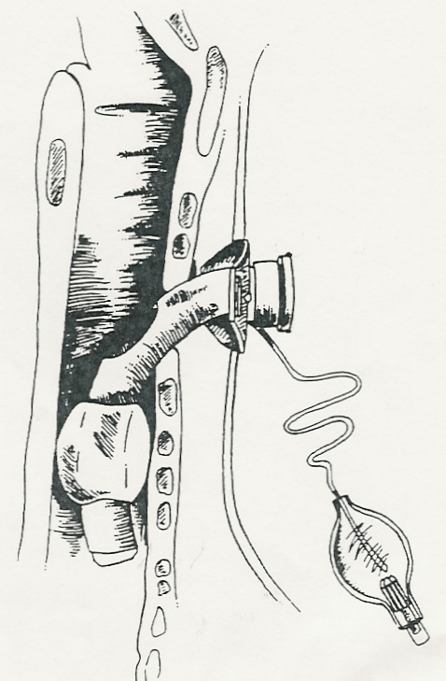
Steps for plugging
Suction upper airway
Deflate cuff as patient coughs
Remove inner cannula
Insert proper plug
Place oxygen on patient’s face

Slide 43
Steps for capping
Suction upper airway
Deflate cuff as patient coughs
Remove inner cannula
Replace with fenestrated inner cannula
Place cap on inner cannula
Place oxygen on patient’s face

Slide 44
Fenestrated Tubes
Why do I absolutely have to open the fenestration port and deflate the cuff before capping (plugging) a trach tube?

Slide 45
Fenestrated Tubes
Why do I absolutely have to open the fenestration port and deflate the cuff before capping (plugging) a trach tube?
Simple – if you don’t – the patient will suffocate!!!!!!!

Slide 46
Fenestrated Tubes
Why should I replace the solid inner cannula before I suction the fenestrated trach tube?

Slide 47
Replace the solid inner cannula before suctioning the airway to prevent the catheter from protruding out the fenestration port and causing tissue trauma.

Slide 48
Fenestrated Tubes
What should I do if I cannot remove the fenestrated inner cannula or get an inner cannula back in the trach tube?

Slide 49
Tissue may occasionally migrate into fenestration port preventing insertion or removal of the fenestrated inner cannula.
Manipulate the entire tube slightly to loosen tissue but if unsuccessful or if bleeding begins, contact physician.

Slide 50
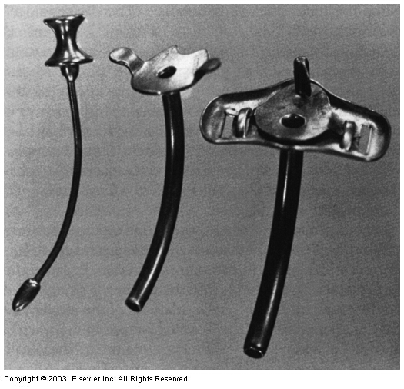
Inner cannula
7.
Egan
Fig. 33-1
Jackson tracheostomy tube made from silver.It has no cuff and no 15-mm adapter.
Obturator
Outer cannula

Slide 51
Metal tube (Jackson or Silver Holinger)
Made of sterling silver.
Not used very often in acute care because they are uncuffed and do not have a 15 mm connection needed for ventilation.
They are also hard and do not conform to the airway anatomy.
May be seen in long term trach patient or laryngectomy.

Slide 52
Metal Tracheostomy Tube
Set up the patient’s room before a problem occurs :
If it is a tracheostomy patient; be sure there is the proper size 15 mm adapter attached to the resuscitation bag and a (face) mask available in the room at all times
If it is a laryngectomy patient; be sure there is the proper size 15 mm adapter attached to the resuscitation bag and also a (stoma) mouth seal/ or small mask attached to the resuscitation bag

Slide 53
Metal tube (Jackson or Silver Holinger)
What do I do if I have to ventilate a patient with a metal trach tube (or any other cuffless trach tube)?

Slide 54
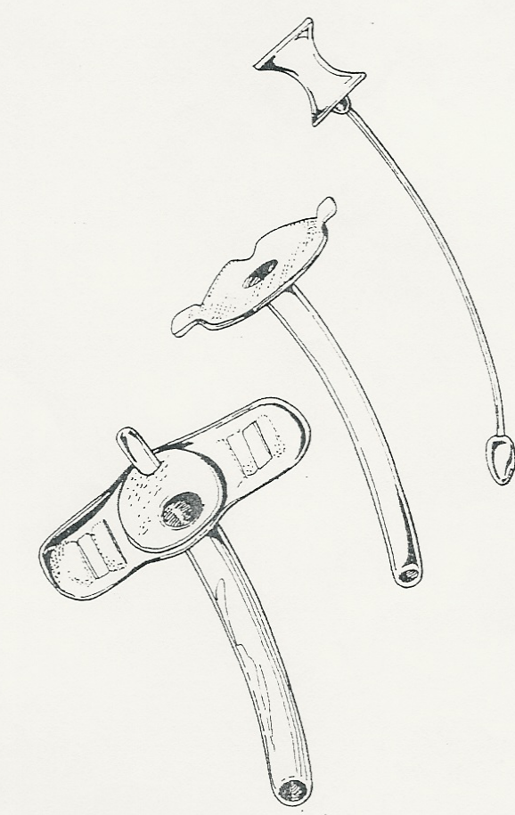
If it is a tracheostomy patient
Attempt to bag through the tube (need 15mm adapter)
If leak is too big – remove the tube, cover the stoma and bag mask ventilate until a cuffed tube can be placed.
Insert a cuffed trach tube or small ET tube into the stoma & ventilate

Slide 55
If it is a laryngectomy patient
Attempt to bag through the tube (need 15mm adapter)
If leak is too big – remove the tube, cover the stoma with the small mask or mouth seal and ventilate
Insert a cuffed laryngectomy tube or small ET tube into the stoma & ventilate

Slide 56
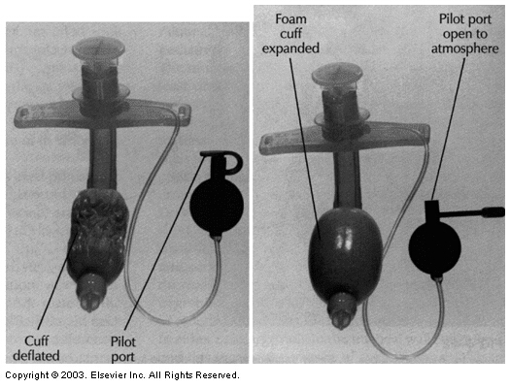
8. Fig. 33-32 Foam cuff is deflated on insertion. The pilot tube is opened after the tube is in place.

Slide 57
Foam cuff
It is often used when there has been difficulty maintaining a seal and ventilating possibly due to tracheal dilation.

Slide 58
Foam cuff
INSERTION:
Use a syringe to deflated the cuff which is filled with polyurethane foam before insertion
Once in place, leave the cuff line open to atmospheric pressure to allow the cuff to conform to the shape of the trachea
NOTE: There is no pilot balloon valve on the pilot balloon line.

Slide 59
Precautions
Lubricate suction catheter before inserting to prevent hanging up on tube this silicon tube
Use trach wedge to disconnect equipment. Never twist the trach tube as distal trachea damage nay occur.

Slide 60
Foam cuff
In cases of severe leaks, the pilot balloon line can be adapted in-line in the ventilator circuit so when the ventilator circuit pressurizes, the cuff is inflated to hold a seal.
May accumulate moisture in cuff faster
PEEP may cause increased gas pressure in the cuff on exhalation

Slide 61
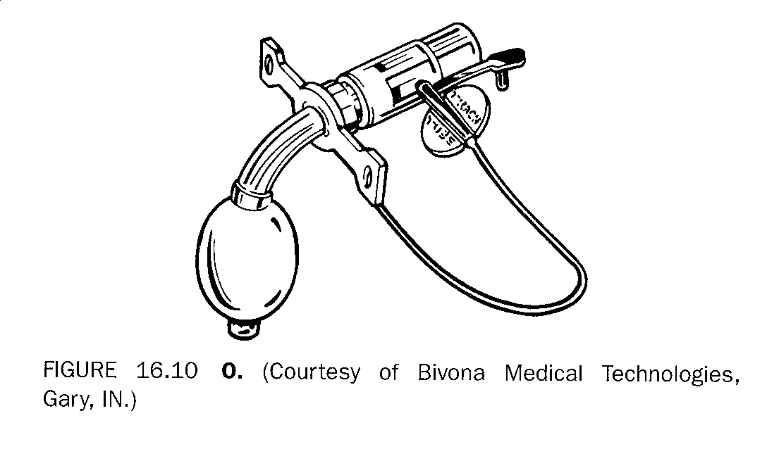
Foam cuff with inline adapter which inflates cuff during mechanical ventilation inspiratory pressure.

Slide 62
Foam cuff
MAINTENANCE:
Every 8 - 12 hours (Q shift) the cuff is deflated completely
Removes any moisture or debris
Checks for cloudy fluid and possible bacteria in cuff
Checks integrity of the cuff
Do not measure cuff pressure
measure and document volume of air.
If volume is increasing then the trachea may be enlarging

Slide 63
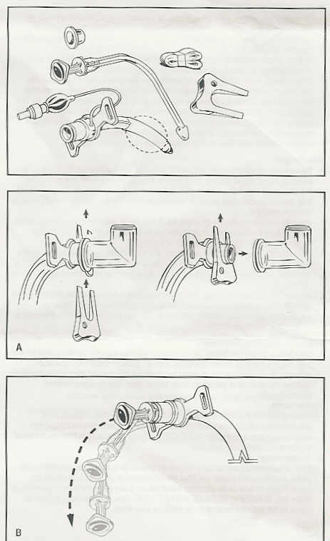
9. Bivona TTS
(Tight To Shaft)
May reprocess for single patient use (steam autoclave)
Must use disconnect wedge to prevent tube damage
Inflate cuff with sterile water
Use MOV technique

Slide 64
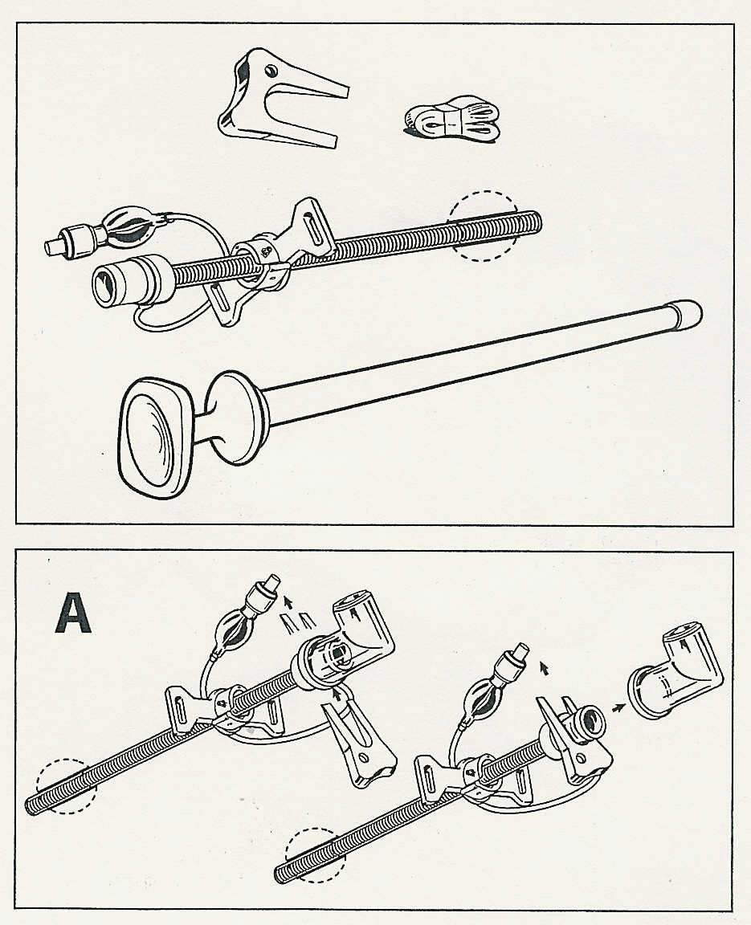
Bivona TTS
(Tight To Shaft)
Gives profile of cuffless when deflated
Cannot see floppy cuff = sterile water
http://video.smiths-medical.tv/services/player/bcpid784767379001?bckey=AQ~~,AAAAAEBRJ4w~,jnMMg6V5IsDF_lDBR0B4Jj6ceZ1yk6k2
Cuff visible (floppy) = air

Slide 65
Trach Accessories

Slide 66
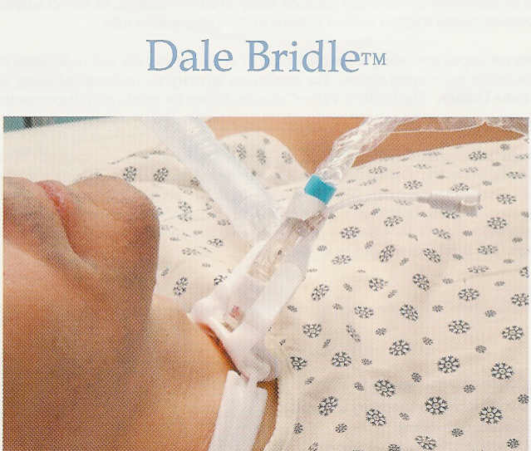
Helps prevent ventilator circuit disconnects

Slide 67
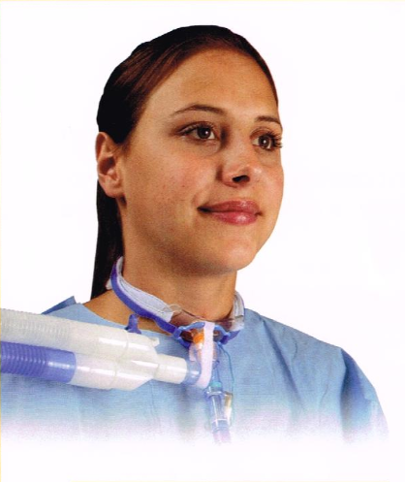
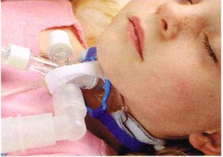
TrachGuard anti-disconnect devices

Slide 68
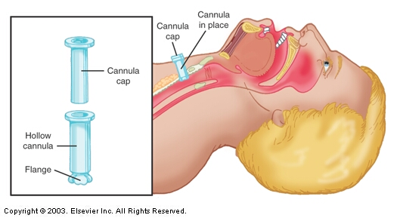
Egan Fig. 33-36 Tracheostomy button.

Slide 69
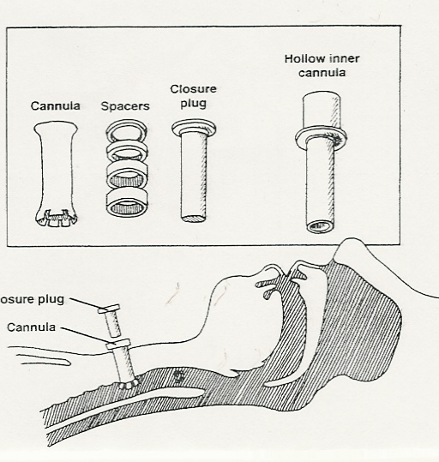
Accessories
Tracheal Button

Slide 70
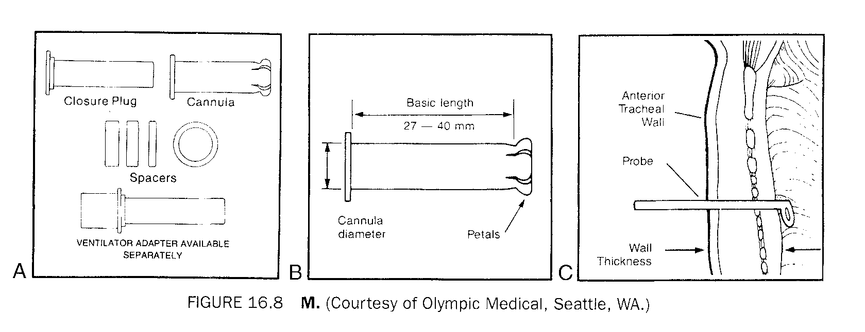
Trach Button - Measure thickness of anterior wall to determine the number of spacers needed for a comfortable fit.

Slide 71
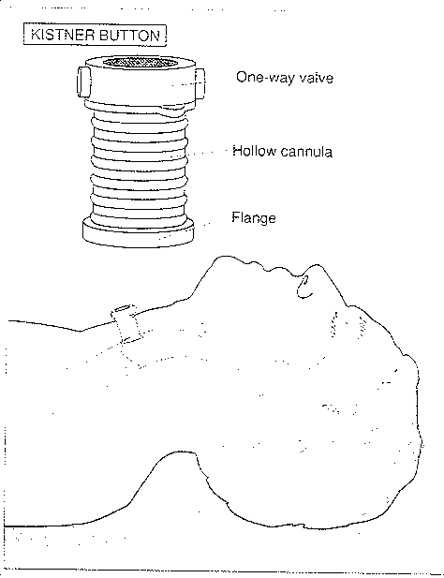
Kistner Button
Used to wean patients
from trach tube
Keeps stoma open
Has one-way valve so
patient inspires through
button and exhales
through upper airway

Slide 72
Montgomery Tube
http://www.youtube.com/watch?v=a3OH7uusHM8

Slide 73
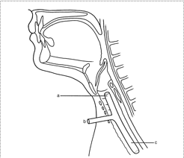
Montgomery T-tube
Used after laryngotracheal surgery
Used to maintain an adequate airway
Used to provide support to the stenotic trachea
Maintenance:
Can be suctioned
Can have speaking valve added
http://www.youtube.com/watch?v=kmN9qEgKhR0

Slide 74
Laryngectomy

Slide 75
Laryngectomy
Used for patients who have had larynx removed
Special precautions necessary because patient does not have use of upper airway for conduction of air
Be prepared to ventilate stoma (ped. mask, mouth seal…)
Remove face mask from room
Have replacement tube at bedside
Put signs over bed indicating laryngectomy

Slide 76
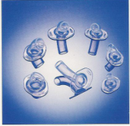
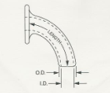
Laryngectomy Tubes

Slide 77
Critical Thinking Question
You enter the room of a ventilator patient who has a laryngectomy. The ventilator alarms are sounding and the laryngectomy tube is lying on the bed. The patient has no spontaneous respirations.
Describe in detail what you would do.

Slide 78
Laryngectomy
Attempt to ventilate the stoma (ped. mask, mouth seal…)
Replace soiled tube with spare tube at the bedside
In an emergency – a pediatric tube can be placed in the stoma

Slide 79
For a patient who loses their trach tube…
Place mouth seal on 15mm connector of resuscitation bag and use to seal over stoma
Use a neonatal resuscitation mask over stoma

Slide 80
Communication Devices

Slide 81
Communication Aides
Fenestrated or uncuffed trach tubes
Cap
Plugs

Slide 82
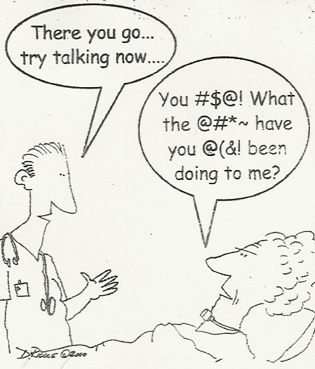
Speaking devices
Make sure both you & the patient are prepared for speech.
What is the main drawback to speaking valves for trachs?

Slide 83
Speaking devices CAP
With cap, patient breaths in and out through upper airway.
Need fenestrated tube and fenestrated inner cannula
May not be as well tolerated due to airway resistance
Inspiration
Exhalation
Both.

Slide 84
Steps for capping
Suction upper airway
Deflate cuff as patient coughs
Remove inner cannula
Replace with fenestrated inner cannula
Place cap on inner cannula
Place oxygen on patient’s face

Slide 85
Speaking devices Plug
With plug, patient breaths in and out through upper airway.
Need fenestrated tube but not fenestrated inner cannula
May not be as well tolerated due to airway resistance
Inspiration
Exhalation
Both.

Slide 86
Steps for plugging
Suction upper airway
Deflate cuff as patient coughs
Remove inner cannula
Insert proper plug
Place oxygen on patient’s face

Slide 87
Questions
SCENARIO: You have a spontaneous breathing trach patient on a 40% trach collar.
If you plug the trach, how do you administer the 40% oxygen?
To the face: nasal cannula, air entrainment mask, aerosol mask…

Slide 88
Communication Aides
b) One-way valves:
Passy-Muir
Phonate (Covidien)
See directions for application to:
Non-ventilated patient
Ventilated patient
See Performance Evaluation

Slide 89
Speaking devices Valves
Speaking valves are used in place of plugs or caps
Less airway resistance
Allows inspiration through trach
Allows exhalation through upper airway
Oxygen is usually place over the artificial airway

Slide 90
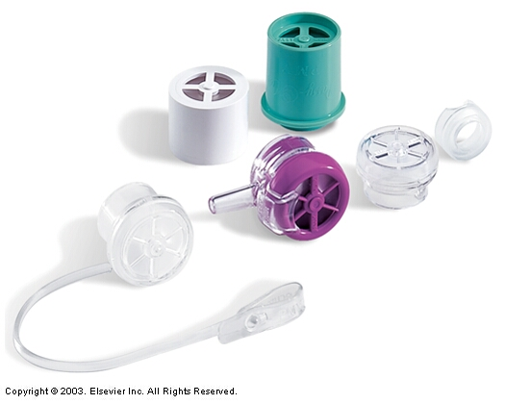
Watch
Passy-Muir DVD
in class
Egan Fig. 33-28 Passy Muir family of valves including one that can be used to deliver oxygen to the tracheostomy patient.

Slide 91
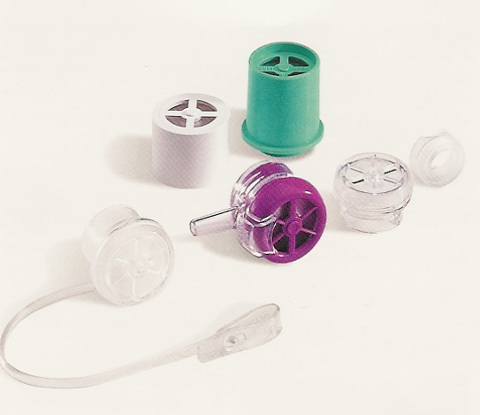
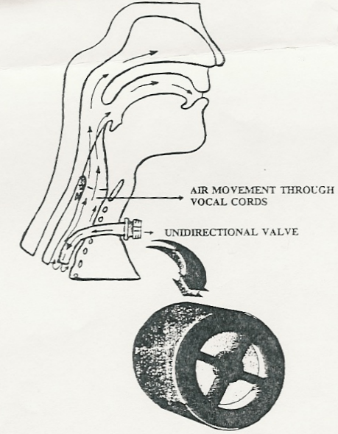
Passy-Muir Valves
Speech
Smell
Swallow
Airway clearance
May reduce aspiration

Slide 92
Questions
SCENARIO: You have a spontaneous breathing trach patient on a 40% trach collar.
If you apply a Passy Muir valve, how do you administer the 40% oxygen?
Trach collar

Slide 93
Questions
SCENARIO: You have a tracheostomy patient preparing to go home on a ventilator. You want to begin teaching the patient to use a Passy Muir valve.
What are some of the problems associated with use of a Passy Muir valve on a ventilator patient?
Loss of exhaled volume out upper airway
Low tidal volume delivery due to leak
Loss of PEEP
Increased spontaneous respiratory rate to compensate for volume loss
Increased CO2
Desaturation from loss of MAP
Ventilator alarms (low volume & pressure)
Aspiration due to deflated cuff
(See handout on proper procedure)

Slide 94
Critical Thinking Question
Al Strachen is a 16-year-old quadriplegic with C-7 fracture caused by a diving accident. He is currently in a rehabilitation facility. He has a size 6 nonfenestrated tube in place. The physiatrist has requested that the nurse provide a tracheostomy adjunct to allow the patient to speak. The nurse obtained a Passy-Muir valve and attached it to the 15-mm adapter of the inner cannula. You were then called stat to evaluate the patient for severe respiratory distress.
Explain why the patient did not tolerate the procedure and what you would need to do to correct the situation.

Slide 95
Other Communication Tools and Options
Buttons
Talking Trach Tubes
Sign language
Computers (e-mail & telephone hook-ups)
Electro-larynx
Esophageal Speech or “Burp” talking
Surgery – TEP Prosthesis
Tracheoesophageal Puncture

Slide 96
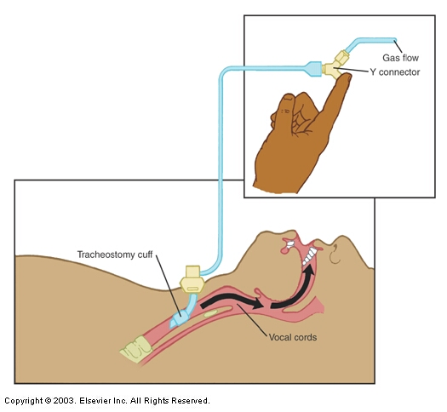
Provide a gas flow of air or O2 above the cuff and through the cords to facilitate speech
Egan
Fig. 33-27 "Talking" tracheostomy tube.

Slide 97
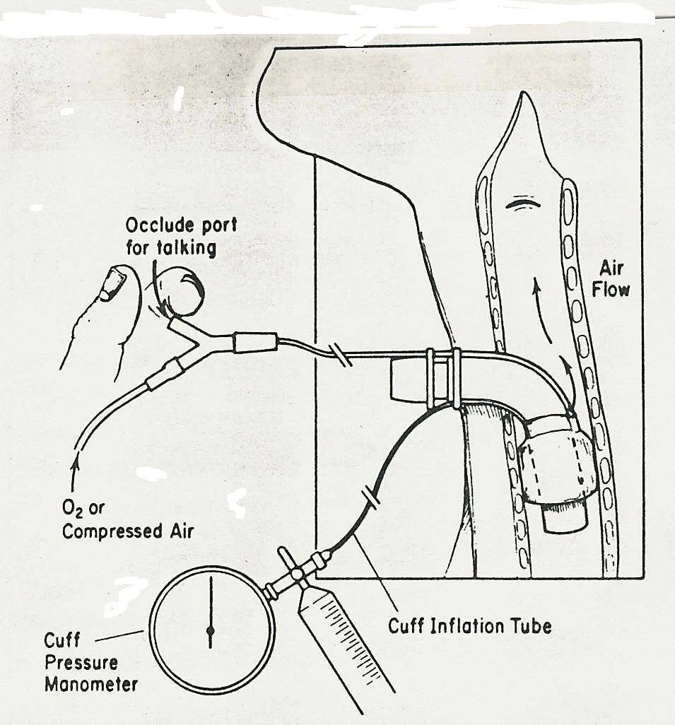

Slide 98
What if the patient does not have vocal cords??
Laryngectomy patients have options as well
Electro-larynx
Esophageal Speech or “Burp” talking
Surgery – TEP Prosthesis
Tracheoesophageal Puncture

Slide 99
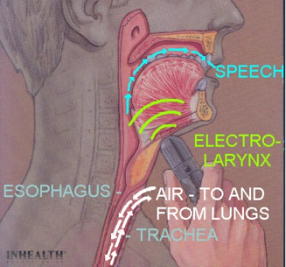
Electrolarynx

Slide 100
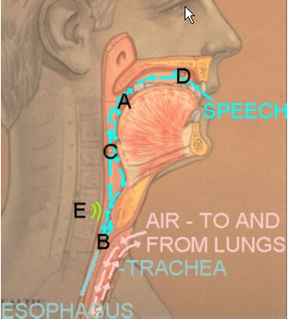
Esophageal Speech

Slide 101
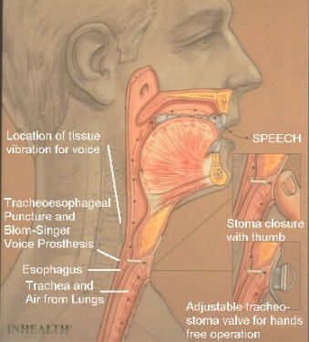
Tracheoesophageal Puncture & Prosthesis (TEP)

Slide 102
Decannulation

Slide 103
Decannulation
Progressive decrease in size of trach tube
Change to fenestrated or uncuffed tube then cap or plug or use valve

Slide 104
Swallow Testing
Before cuff is deflated or removed - assess aspiration risk:
Obtain sterile water mixed with blue dye
Suction the patient orally and deflate the cuff
Suction the airway
Have the trach patient drink some of the mixture
Suction the airway again
If blue dye is suctioned, the patient is aspirating

Slide 105
Decannulation Process #1
Decrease in size of trach tube
Change to progressively smaller/uncuffed tubes
Eventually remove the tube
Do not suture stoma
Surgical closure is not usually needed
Apply sterile dressing and possibly topical antibiotic
Clean site periodically
Encourage cough and breathing exercises

Slide 106
Decannulation Process #2
Switch to fenestrated or uncuffed trach to get patient accustomed to use of upper airway.
May add cap, plug or speaking valve
Eventually remove tube
Do not suture stoma
Surgical closure is not usually needed
Apply sterile dressing and possibly topical antibiotic
Clean site periodically
Encourage cough and breathing exercises

Slide 107
Home Care

Slide 108
Home Trach Care
Be sure all upper airway functions are understood and taken care of:
Conducting air
Warm gas
Humidify gas
Filter gas
Protect airway

Slide 109
Home Care
Arrange for home care equipment & supplies
Medical Alert “Neck Breather”
Trach care
Suction
Aerosol
Oxygen or compressor
Instruct patient & family members

Slide 110
Education
CONDUCTING AIR:
Perform trach care
Avoid use of harsh soaps or full strength peroxide as they can be irritating & increase coughing
Suction airway
Prepare a “GO” bag for traveling
Use saline instillation as needed

Slide 111
Education
WARM GASES:
Avoid temperature extremes
Stay inside in bad/cold weather
Keep trach covered
Wear lint free scarf, clean cotton t-shirt put on backwards, gauze, bib or HME

Slide 112
Education
HUMIDIFY GAS:
Drink extra fluids
Use cool aerosol set-up
Use HME
Keep home humidified
Stay indoors during extremely cold weather
Keep trach covered

Slide 113
Education
FILTERING:
Use lint free cloths to clean trach (do not use tissues near trach)
Keep trach covered
Avoid fumes, aerosols, dust, airborne droplets, people with respiratory infections, insects

Slide 114
Education
PROTECTION:
Use caution when bathing and showering
Avoid water sports
Cover trach with plastic bib when showering
Prevention – hand washing, equipment processing, clean technique…

Slide 115
Education
Contact doctor or HC provider
Monitor for symptoms – difficulty breathing, bleeding, fever, malaise, sputum change, redness, swelling, pain…

