Slide 1
RSPT 2335
Module A
AIRWAY MANAGEMENT
Part 2a
Tracheal Airways

Slide 2
Parts of Module A AIRWAY MANAGEMENT
Part 1 – Pharyngeal, Laryngeal & Esophageal Airways
Part 2 – Tracheal Airways
Part 3 – Airway Clearance
Part 4 - Advanced Airways
Part 5 - Airway Complications & Emergencies

Slide 3
OBJECTIVES
At the end of this module, the student should be able to do the following regarding tracheal airways…
identify airways, components and accessories
list indications, contraindications, hazards & complications, advantages and disadvantages
prepare, insert, place and secure
airway maintenance including cleaning, securing and cuff pressures.
airway removal
use speaking devices & buttons.
educate a patient going home with an airway.

Slide 4
RESOURCES
AARC-Clinical Practice Guidelines:
“These AARC’s guidelines enhance respiratory practice and provide a framework for RT protocols. “
Endotracheal Suctioning of Mechanically Ventilated Patients with Artificial Airways (revised 2010)
Nasotracheal Suctioning
Management of Airway Emergencies
Removal of the Endotracheal Tube (revised 2007)
Bronchoscopy Assisting

Slide 5
RESOURCES
Other Guidelines:
ASA - Practice Guidelines for Management of the Difficult Airway

Slide 6
Major Topics
Oral Intubation Verification & Stabilization
Nasal Intubation
Ventilator Associated Pneumonia
Alternative Airways & Accessories
Exchanges & Extubation
Tracheostomy Airway Insertion & Changes
Humidity & Oxygenation
Laryngectomy
Communication Devices
Decannulation
Home care

Slide 7
Oral Intubation Verification & Stabilization

Slide 8
Oral Intubation
Uncomplicated Endotracheal Intubation
Review & Practice on your own
Confirming Placement
Securing

Slide 9
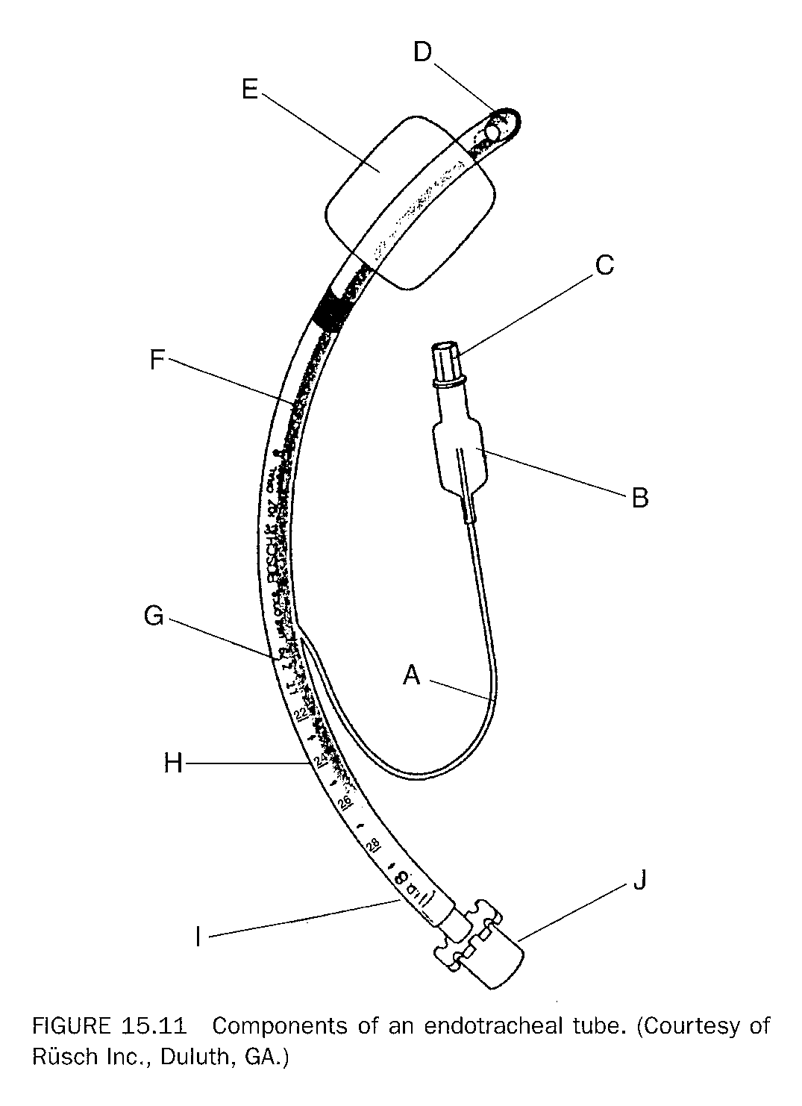
Lab Chapter 22.1.2
Page 351
Identification of the Components of an endotracheal tube

Slide 10
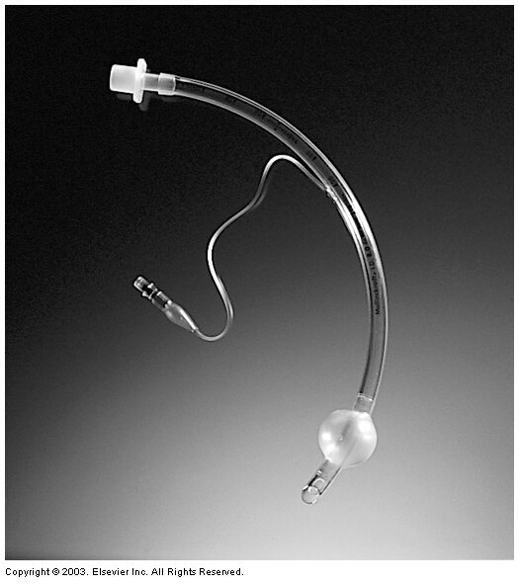
Endotracheal Airways
Oral endotracheal tubes
Nasal endotracheal tubes

Slide 11
Confirming Placement in the Trachea and Depth
During intubation
Depth markings
Physical Assessment
Bedside Tools
Radiography

Slide 12
Confirming Placement
During intubation:
Observe cuff passing through the cords 2 - 3 cm or 1 – 2 inches and then stop.

Slide 13
Confirming Placement
Physical Assessment
Palpate for symmetrical chest movement
Visualize
symmetrical chest movement
condensate inside the ET tube corresponding to exhalation
Auscultate
bilateral breath sounds (upper & middle)
epigastrium to verify there are no ventilation sounds
Observe clinical improvement in color, heart rate, pulse oximetry

Slide 14
Confirming Placement
Use Tools
Pass a suction catheter
Should meet resistance
May stimulate cough
Esophageal detector devices (> 1 yr. olds)
Bulb - Squeeze bulb and if re-inflation occurs then ETT is in trachea
Syringe - Draw back on syringe and if re-inflation occurs then ETT is in trachea

Slide 15
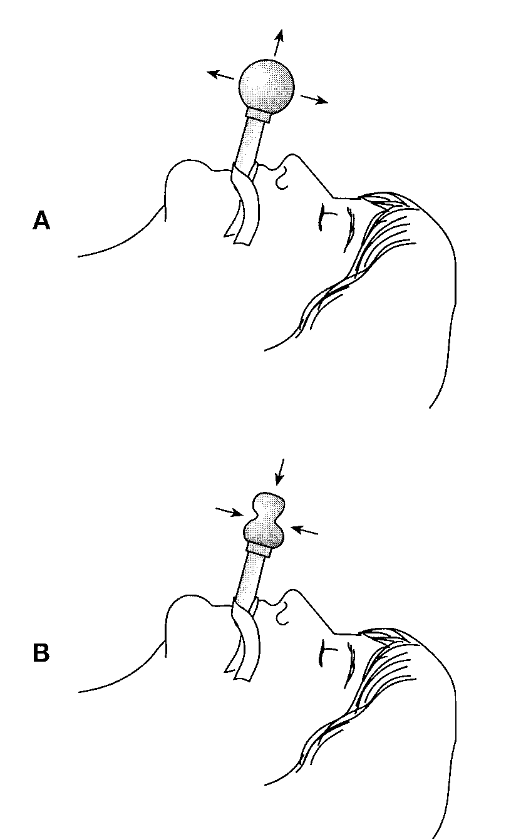
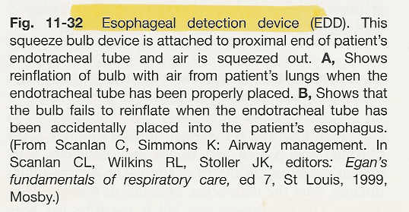

Slide 16
Confirming Placement
Tools for confirming placement in trachea
CO₂ detectors - requires metabolism at the tissues, blood flow to the lungs and ventilation of the lungs to display CO₂
Capnograph - displays CO₂ in mm Hg and gives waveform.
Colorimetric - shows color change (purple/blue to yellow) in presence of CO₂
small & inexpensive with two sizes available
readily available & easy to use
fast acting (after 6 breaths)
disposable (after approx. 2 hours)
sensitive to H₂O

Slide 17
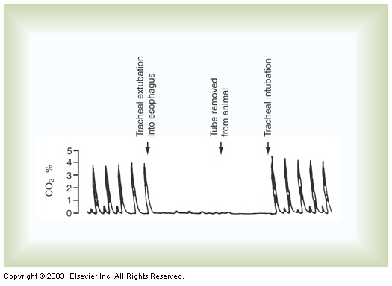
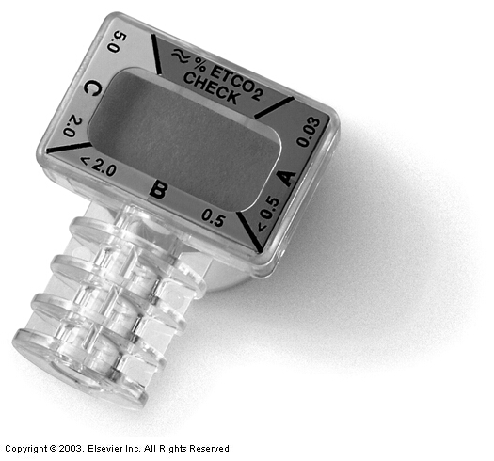
Confirming Placement
A disposable colorimetric CO₂ detector
Capnogram tracing showing changes in expired percent CO₂

Slide 18
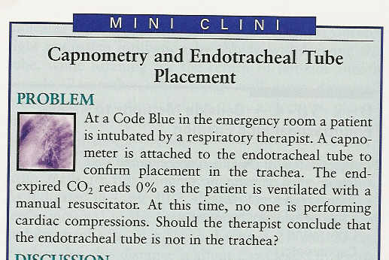

Slide 19
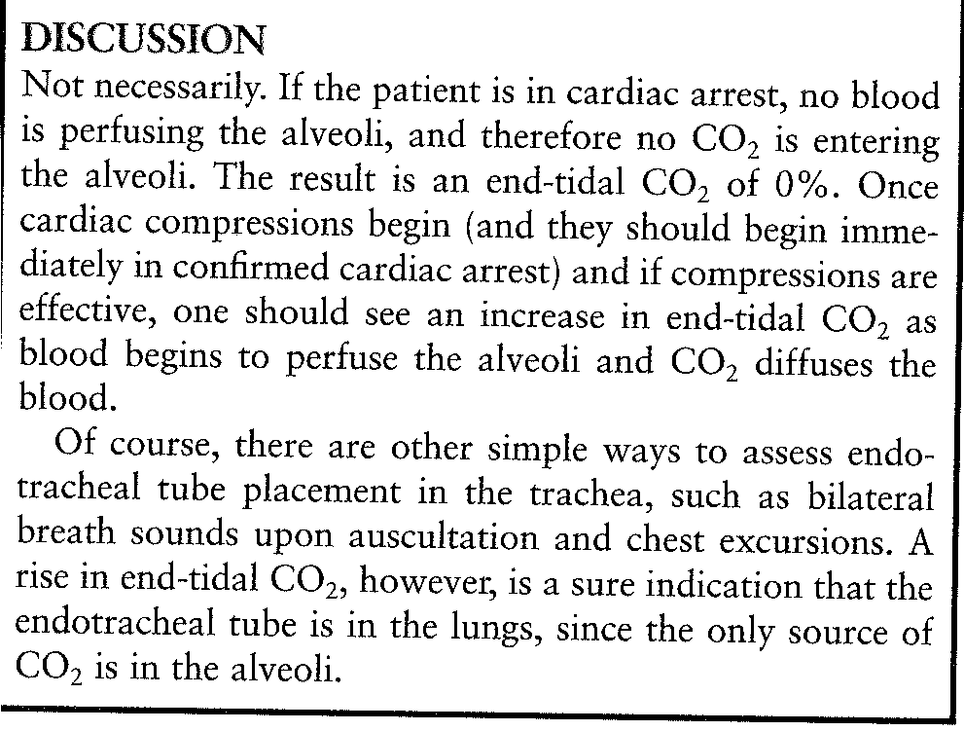

Slide 20
Confirming Placement
Tools for confirming placement in trachea
Lighted wand - Insert down ETT after intubation an if it illuminates neck , the tube has been placed in trachea.
Bronchoscopic visualization of carina or tracheal rings through the tube.

Slide 21
Confirming Placement
Radiography for confirming placement
Chest radiograph - most reliable technique but takes the longest to obtain
Radiopaque line on ETT can be visualized easily
Lateral for tracheal placement

Slide 22
Confirming Depth
Radiography for confirming depth
Chest radiograph - most reliable technique but takes the longest to obtain
Radiopaque line on ETT can be visualized easily
AP or PA for depth

Slide 23
Critical Thinking Question 22-4
Describe in specific radiologic terms the proper location of an endotracheal tube.
Answer: Tube tip should be…
1. 2 -3 cm or 1 inch below the cords
2. 2 - 7 cm above the carina at T2 - T4 (2 - 3 in.)
3. At the level of the aortic knob/notch
4. Mid-trachea

Slide 24
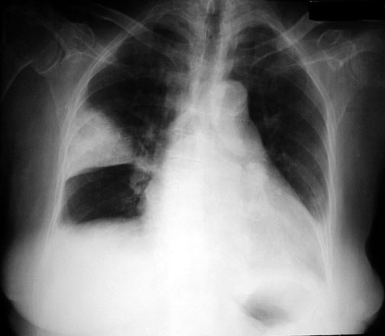
ET Level
Carina Level

Slide 25
Confirming DEPTH not placement
Marking of depth on tube
Depth:
ORAL ETT
Tip to lip in cm
NASAL ETT
Tip to nare in cm
MALE
21 – 23
22 – 24
(Pilbeam)
23 - 25
FEMALE
19 – 21
20 – 22
(Pilbeam)
21 - 23

Slide 26
Securing & Retaping

Slide 27
Securing the Airway
Do not let go of the ETT !!!!!!!!
Carefully remove laryngoscope
Carefully remove stylet
Inflate cuff with enough air (approx. 5 mL) to get gentle pressure in pilot balloon
Ventilate and oxygenate the patient
Secure per hospital protocol

Slide 28
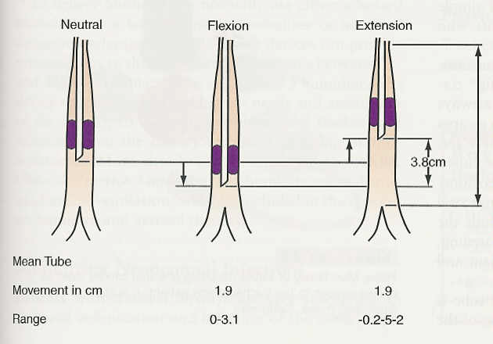
Securing the Airway
Keep head in neutral position (especially infants)
Head flexing moves tube down as much as 3 cm
Head extension raises tube out as much as 5 cm

Slide 29
Securing the Airway
Secure tube with:
Non-porous, water-proof tape
Elastoplast
Umbilical tape
Pre-fabricated harness devices
Anchor Fast
Dale ET tube holder
SecureEast ET Holder
Do not tape gastric tube to tracheal airway!

Slide 30
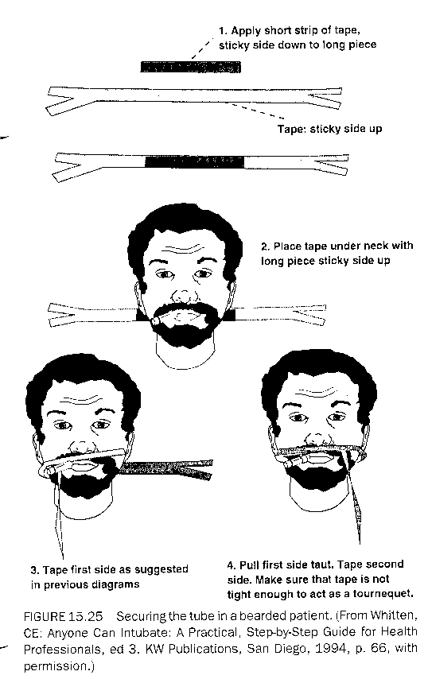
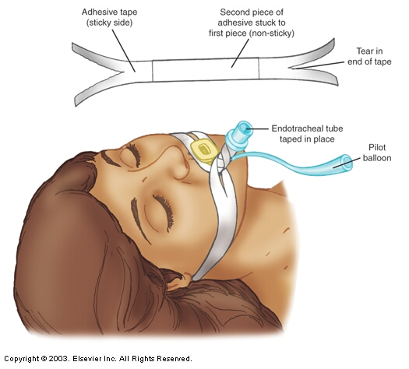
Securing the Airway
Do not use oral airway as a bite block

Slide 31
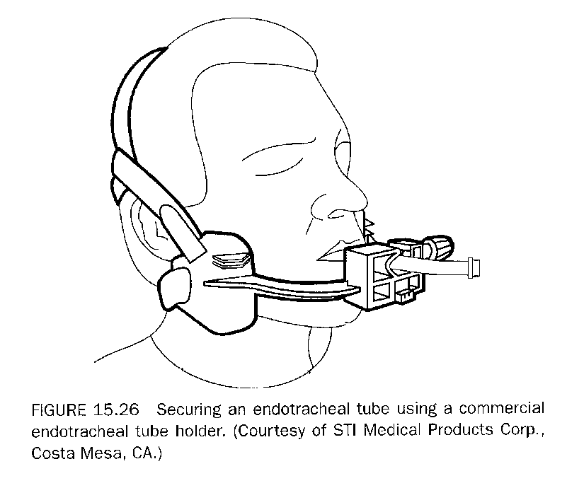
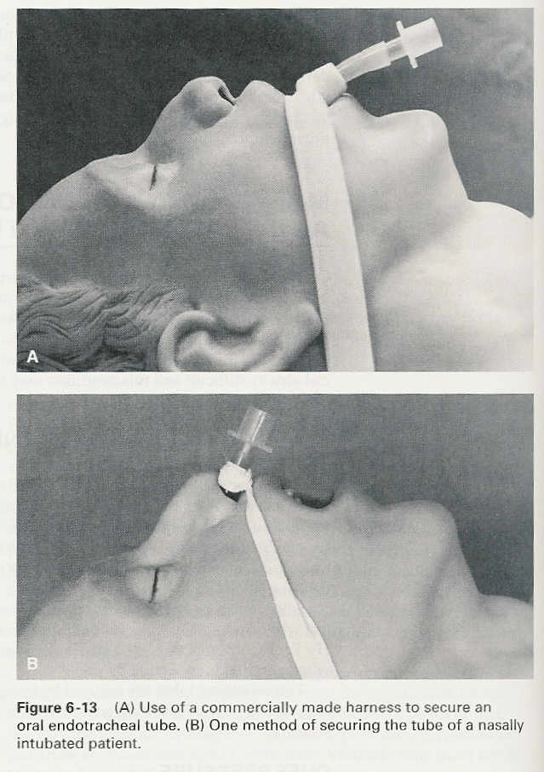
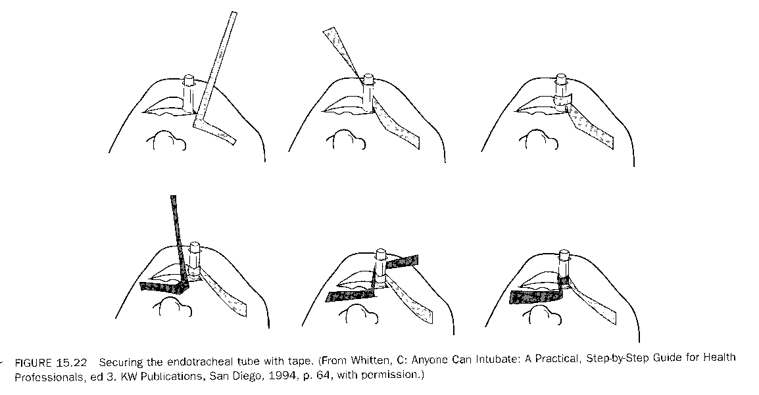
Securing the Airway

Slide 32
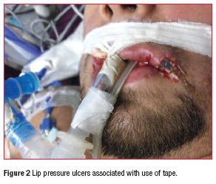

Slide 33
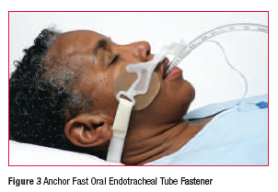
Anchor Fast
Securing the Airway
http://www.hollister.com/us/tube/learning/popup_video.asp?video=AnchorFast

Slide 34
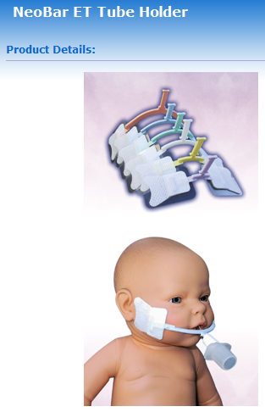
Securing the Airway
http://www.neotechproducts.com/products/neobar/
(Page down to bottom)

Slide 35
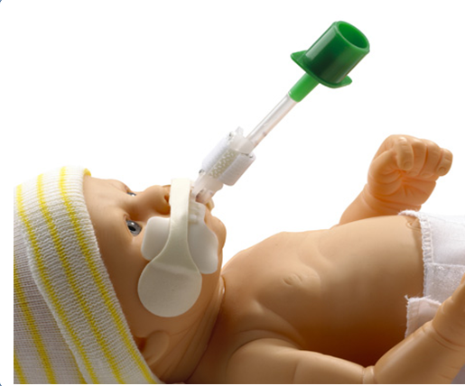
NEO-fit™ Neonatal Endotracheal Tube Grip
Securing the Airway

Slide 36
Retaping
Prepare equipment for retaping:
new tape
shaver
wet and dry wash cloth
suction kit and yankauer catheter
tincture of benzoine
Do not let go of the ETT !!!!!!!!

Slide 37
Retaping
Remove old tape and do not remove hand from ETT
Perform oral care
Wash face
Males may be shaved but use care not to cut pilot balloon
Apply tincture of benzoin on gauze then dab on face
Re-tape tube and verify correct depth

Slide 38
Lab Chapter 22.3
Do Exercise 22.3 – Securing an Endotracheal Tube
NOTE: Do not use OPA as a bite block

Slide 39
Ventilator Associated Pneumonia (VAP)

Slide 40
Nosocomial Infections
Statistics:
Nearly 2 million patients in U.S. hospitals get a healthcare-associated infection (HAI) each year. (5% – 10% of all admissions)
40% of these infections are respiratory infections
86% of these respiratory infections are linked to mechanical ventilation/tracheal airways and are called Ventilator Associated Pneumonia (VAP)
VAP is second most common nosocomial infection in US

Slide 41
Nosocomial Infections
“Aspiration of oral and/or gastric secretions is the primary route of bacteria entry into the lungs and is believe to be the primary factor in the
development of VAP”

Slide 42
Ventilator Associated Pneumonia
Statistics:
According to the AJCC, Ventilator Associated Pneumonia occurs in up to 65% of ventilated critical care patients.
VAP is associated with increases in patient ICU time by up to 22 days
Each incident of VAP is estimated to increase cost by as much as $40,000

Slide 43
Ventilator Associated Pneumonia
Statistics:
About 90,000+ will die annually as a result of VAP
VAP may account for 60% of all deaths due to Healthcare-Associated Infections (HAI)
Mortality that is directly attributable to VAP is estimated to be as high as 27.1%

Slide 44
What can we do about VAP???? 1. Read: Pilbeam Chapter 17: pages 294-305 2. Watch AARC Professor’s Rounds DVD: Minimizing VAP in 2011 – How Respiratory Therapists Can Contribute 3. Take post DVD quiz

Slide 45
Strategies for VAP Prevention
1. GENERAL STRATEGIES
Manage health care associated infection (HAI). as sentinel events
Educate healthcare providers
Conduct surveillance for VAP
Monitor for symptoms - sputum, breath sounds, chest radiograph, fever, WBC (>10% bands neutrophils)
Focus on prevention rather than treatment

Slide 46
Strategies for VAP Prevention
2. Respiratory Therapy Strategies
Hand hygiene
Avoid intubation - use NPPV when possible
Orotracheal intubation preferred over nasotracheal
30 – 45 degree elevation of patient’s head
Avoid gastric over-distension

Slide 47
Strategies for VAP Prevention
Speed up extubation - decrease ventilator days with daily weaning assessment and weaning protocols
Weaning pathway (TDP)
Sedation “holiday”
Avoid unplanned extubation and reintubation
Maintain cuff pressure of at least 20 mm Hg (27 cm H₂O) or minimum occlusive volume/pressure
Use newer style cuffed ET tubes with subglottic suctioning

Slide 49
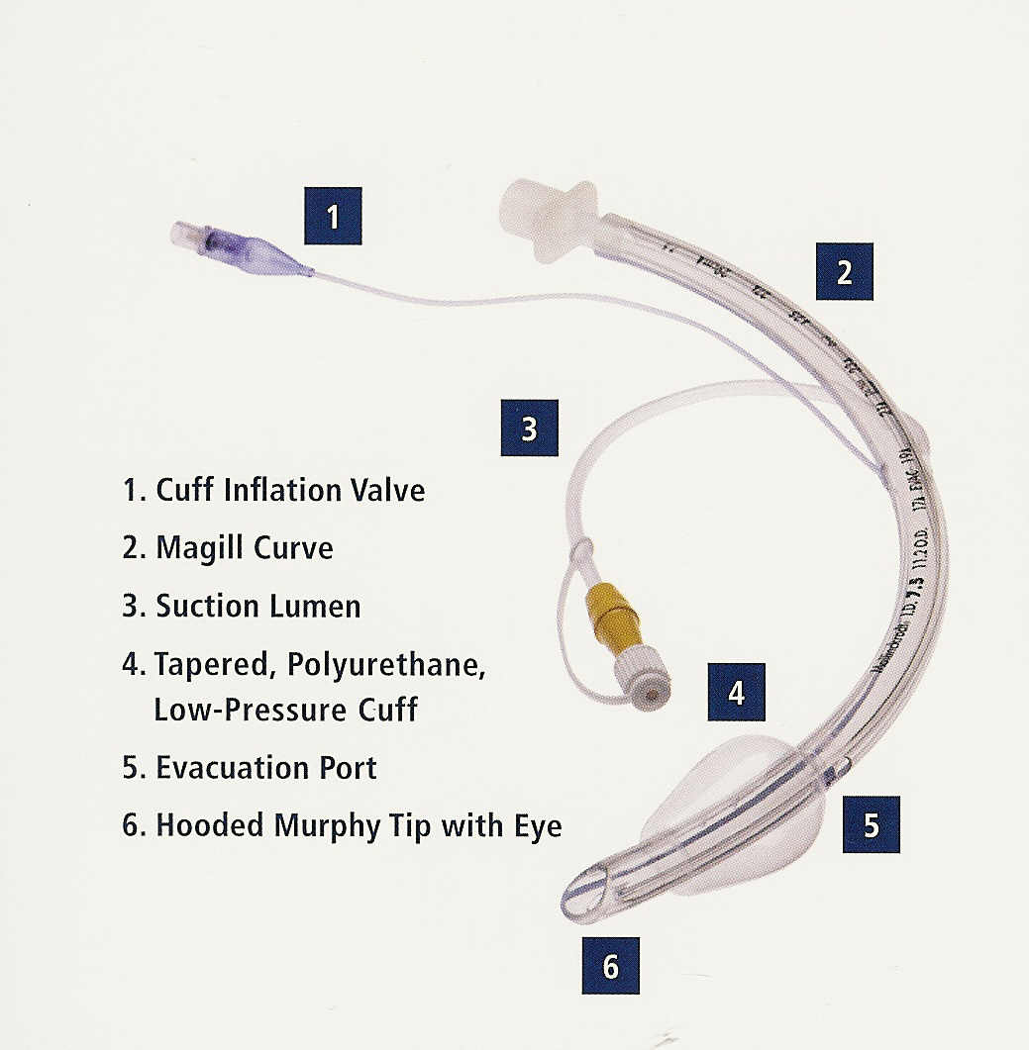
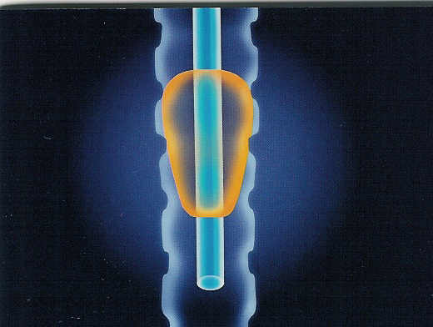
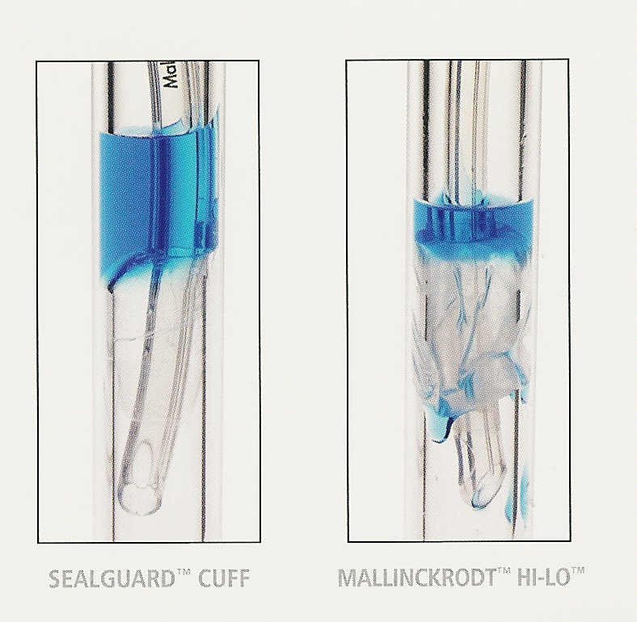
SealGuard Evac Endotracheal Tube
http://www.covidien.com/rms/products/endotracheal-airways/mallinckrodt-taperguard-evac-oral-endotracheal-tube#resources (10:22)

Slide 50
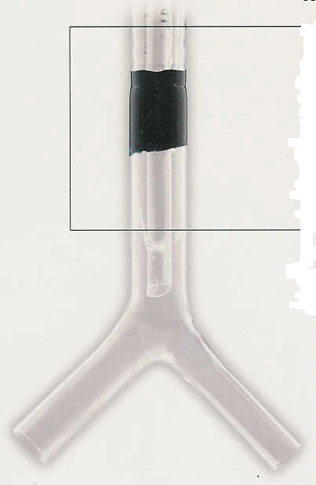
Fluid remains above the Kimberly-Clark Microcuff

Slide 51
Silver Coated Endotracheal Tubes
Research found that in the population with the silver-coated endotracheal tubes:
VAP in all its forms was reduced by nearly 40 percent
highly resistant infections were less than half as likely to occur in those with the silver-coated tubes.
Used to reduce “Time to VAP” occurrence
Prevents bacterial colonization and biofilm formation on tube

Slide 52
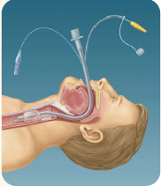
Continuous Aspiration of Subglottic Secretion (CASS)
Endotracheal tube with suction port above the cuff.
Facilitates the removal of pharyngeal secretions that accumulate above the cuff.
May help decrease the incidence of nosocomial pneumonia. (VAP)

Slide 53
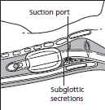
Continuous Aspiration of Subglottic Secretion (CASS)
Processes:
Continuous suction -20 to -60 mm Hg
Or
Intermittent suction -100 to -150 mm Hg
May inject manual air bolus into suction lumen to assure patency as needed.

Slide 54
Critical Thinking Question
Your male patient is intubated with a 7.0 mm orotracheal tube. He is in ICU on a ventilator. The low-exhaled-volume alarm is sounding, and he is phonating. His respiratory rate is 32/min., the heart rate is 122/min., and the pulse oximeter is 89%. You measure the cuff pressure to be 30 cmH2O, and the pilot tube and valve are intact.
What would be your recommendations to remedy this situation?

Slide 55
Cuff pressures (Pilbeam)
20 – 25 mm Hg or Torr
27 - 34 cm H₂O

Slide 56
Strategies for VAP Prevention
More Respiratory Therapy Strategies
Perform regular oral care with an antiseptic solution

Slide 57
Importance of Oral Care
Studies have shown some of the major risk factors for VAP include:
Bacterial colonization of the oral pharynx
Aspiration of subglottic secretions
Colonization of dental plaque

Slide 58
Oral Care Procedure
Prepare equipment for oral care (no kits)
PPE (gloves, fluid shield)
lemon glycerin swabs or sponge swabs
or tooth brush and tooth paste
½ strength mouthwash
basin
suction and yankauer catheter

Slide 59
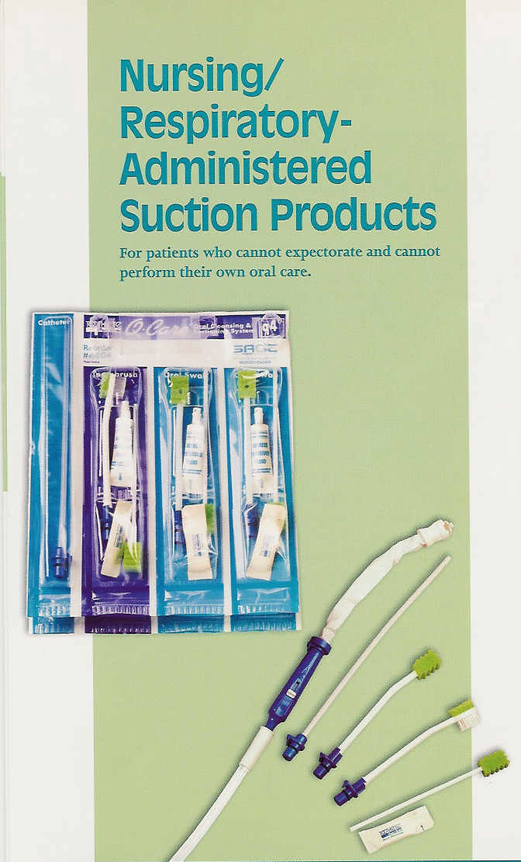
Many products now available include:
Suction tooth brush
Suction swab
Covered yankauer
Peroxide solutions
Oral rinse
Antiplaque solution
Mouthwash

Slide 60
Strategies for VAP Prevention
More Respiratory Therapy Strategies
MINIMIZE VENTILATOR EQUIPMENT CONTAMINATION
Minimal opening of the ventilator circuit
Sterile technique with suctioning & closed suction systems
Remove condensate from ventilator circuits but keep circuit closed during removal
Filter gases (inspiratory & expiratory)

Slide 61
http://www.youtube.com/covidienplc#p/a/u/2/ZmVmm2viFOs
Why should we use filters?
Why shouldn’t we break the circuit?

Slide 62
Strategies for VAP Prevention
More Respiratory Therapy Strategies
MINIMIZE VENTILATOR EQUIPMENT CONTAMINATION
Use sterile water to rinse reusable equipment
HME use if not contraindicated and change HMEs Q 48 hours unless visibly soiled or malfunctioning
Change circuits only when soiled or malfunctioning
Disinfect and store equipment properly

Slide 63
Strategies for VAP Prevention
3. Other Strategies
REDUCE DIGESTIVE TRACT COLONIZATION
NG tube placement
Feed Patient: Parenteral nutrition or Duodenum feedings (J tube or Dobhoff)

Slide 64
Strategies for VAP Prevention
3. Other Strategies
Deep vein thrombosis prophylaxis (DVT)
Avoid acid-suppressive therapy when not indicated for stress ulcers or gastritis
If indicated – use stress bleeding prophylaxis (gastric H2 blockers or sucralfate)
Tight glycemic control

Slide 65
Lab Chapter 24
Oral Care Videos:
http://www.sageproducts.com/products/oral-hygiene/video.cfm?name=RXThumbPort
http://www.kchealthcare.com/products/respiratory-health/kimvent-oral-care-solutions.aspx
http://www.intersurgical.com/products/critical-care/oral-care#videos
Do Exercise 24.2
Re-securing and Repositioning of an Endotracheal Tube
Practice Oral Care procedure

Slide 66
Alternative Airways and Accessories

Slide 67
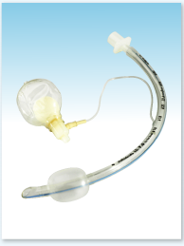
Hi-Lo™ Endotracheal Tube with Lanz™ Pressure Regulating Valve
Lanz™ valve automatically maintains intra-cuff pressure to approximately 30 cm H₂O.
Lanz™ valve reduces the need for manual cuff pressure monitoring.

Slide 68
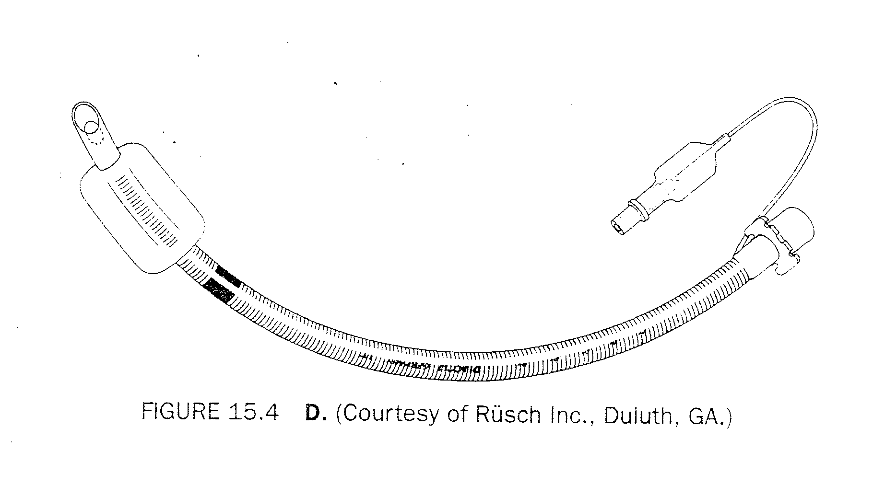
Spiral Steel Reinforcing Wire
Anode or (Deane) tube has spiral steel reinforcing wire which prevents kinking when the tube must be bent out of the way of a surgical field

Slide 69
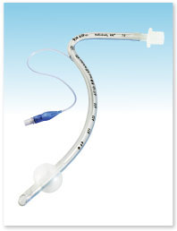
Nasal RAE™ Endotracheal Tube
Preformed curve removes circuit from surgical field.
Unique design helps protect against kinks and disconnects.
Indications For Usage
Oral Surgery
Maxillofacial surgery

Slide 70
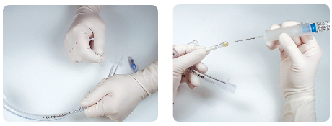
Emergency Medicine Tube (MET)

Slide 71
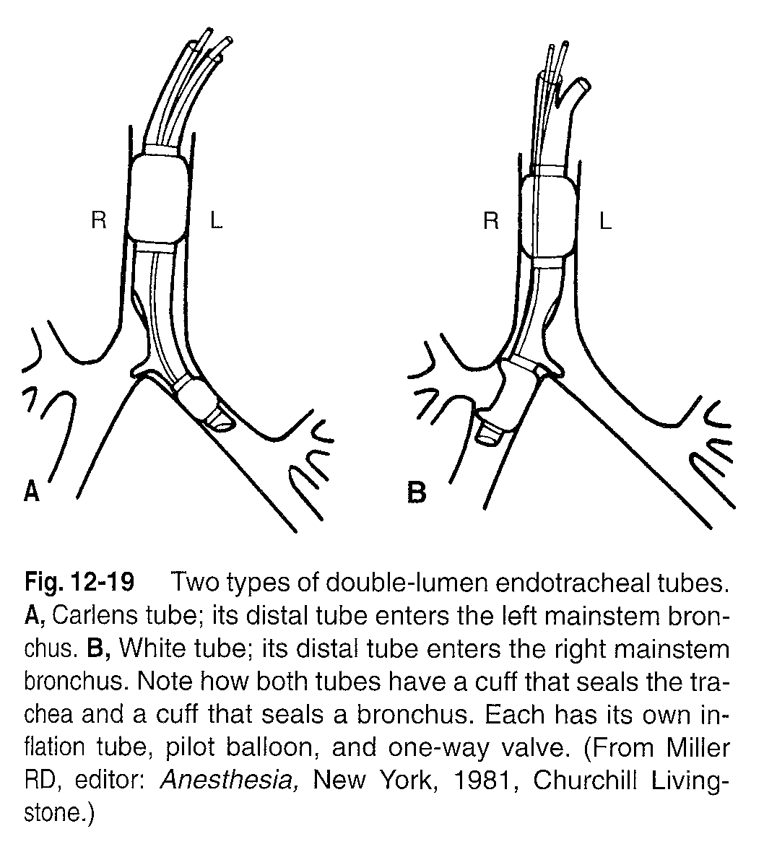
Double Lumen Endobronchial Tube

Slide 72
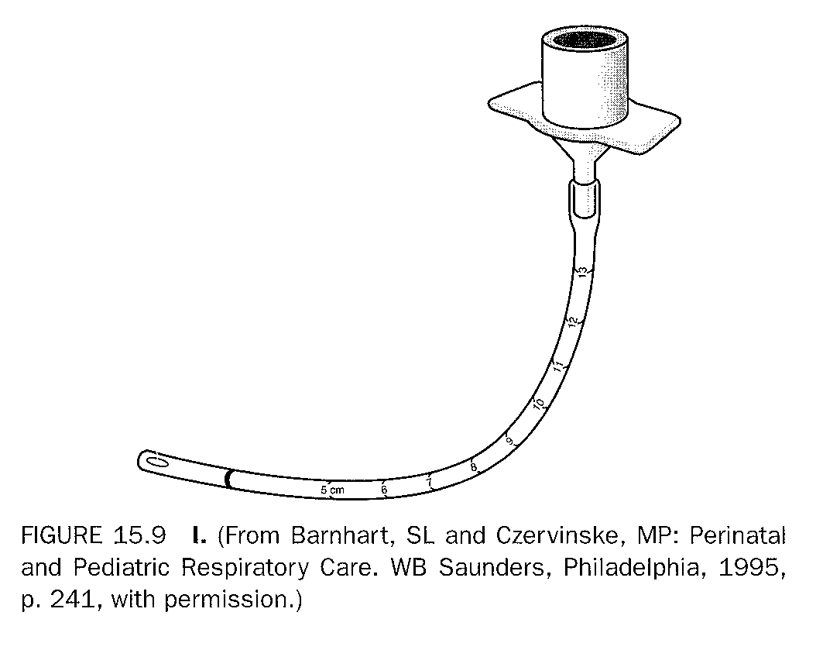
Infant & Pediatric Endotracheal Tubes
May be uncuffed up to
size 5.5 – 6 mm ID
or
4 – 6 yrs. old
Cuffless endotracheal tube

Slide 73
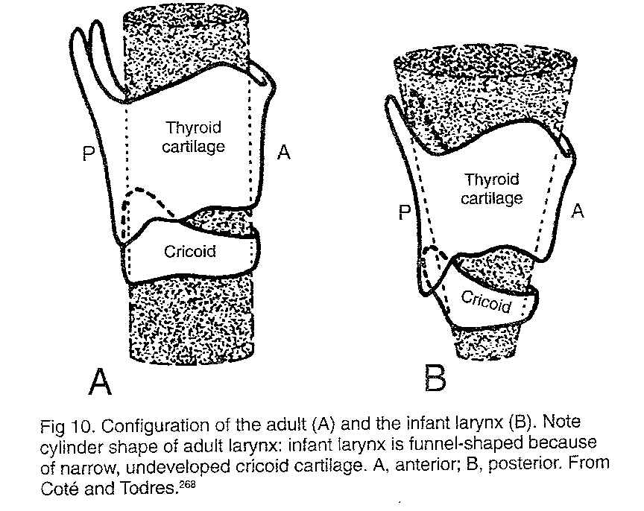

Slide 74
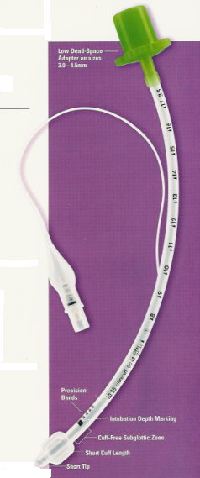
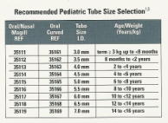
Pediatric Cuffed ET Tubes

Slide 75
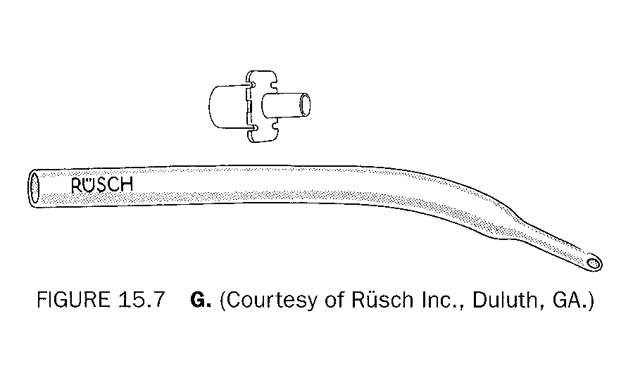
Infant & Pediatric Endotracheal Tubes
Cole – tapered airway
Not in use any more

Slide 76
Pediatric ET Size Calculations
8 & older:
Size of ET tube (ID) = age in yrs - (age/4) (8 yr: 8-2=6)
OR
Size of ET tube (ID) = 16 + age in yrs (8 yr: 24/4=6)
4
2 years and older:
Age 2 years uses 5.0 mm and for every two years thereafter up to 14 years add 0.5 mm
(8 yr = 5 + 1.5 = 6.5)

Slide 77
Pediatric ET Depth Calculations
1. Pediatric ET Depth = 12 + (age/2)
OR
2. Infant ET tube depth use “Rule of Seven”
1 kg = depth of 7cm @ lip
2 kg = depth of 8cm @ lip
3 kg = depth of 9cm @ lip
4 kg = depth of 10cm @ lip

Slide 78
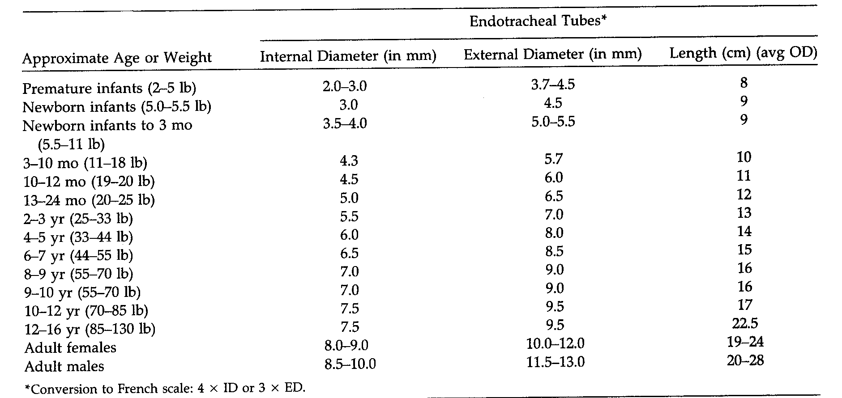
Use the Chart

Slide 79
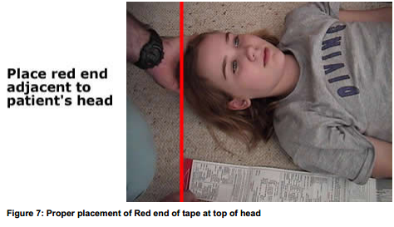
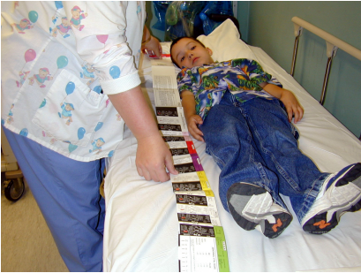
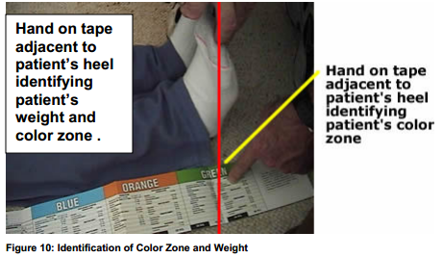
Broselow™ Pediatric Resuscitation System

Slide 80
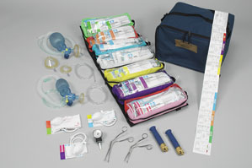
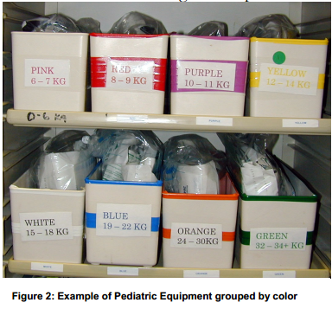
Broselow™ Pediatric Resuscitation System

Slide 81
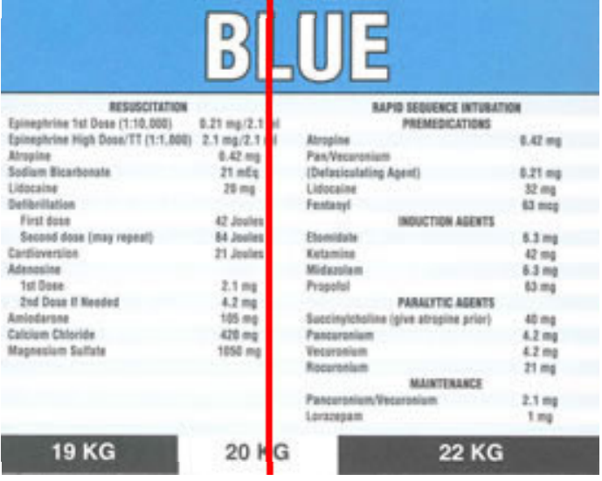

Slide 82
Infant Practice
Selecting equipment
Intubation
Positioning
Securing

Slide 83
Exchanges & Extubation

Slide 84
ET Tube Exchanges

Slide 85
Exchanging the ET Tube
Reasons:
Cuff torn
Pilot line cut
Pilot valve broken
Larger or different tube needed
Airway becomes obstructed

Slide 86
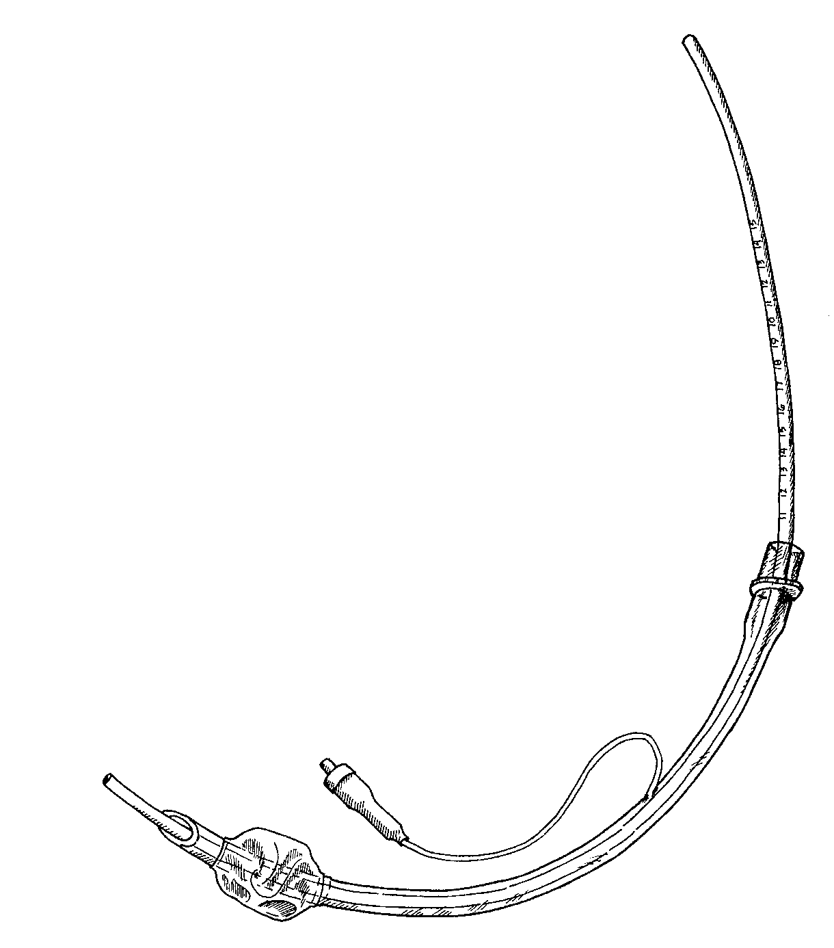
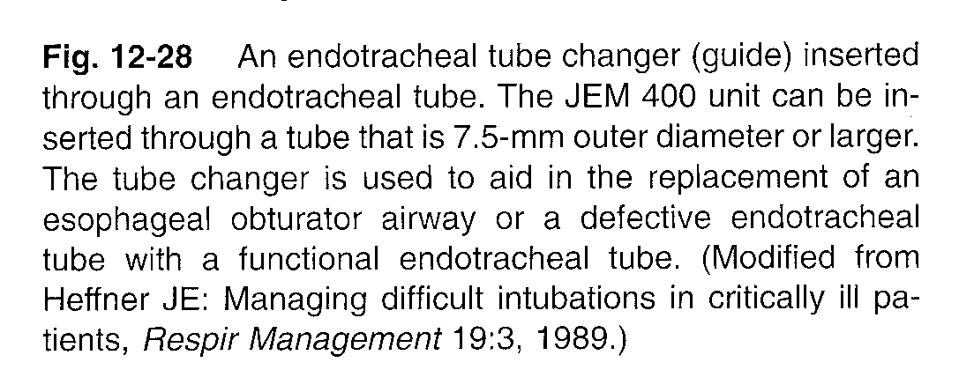

Slide 87
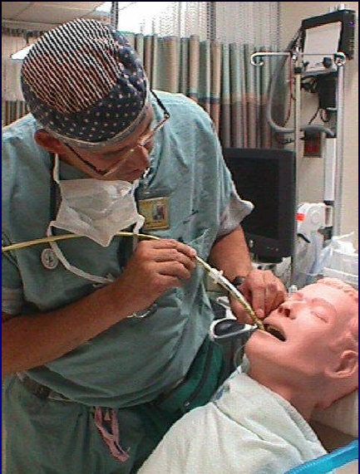
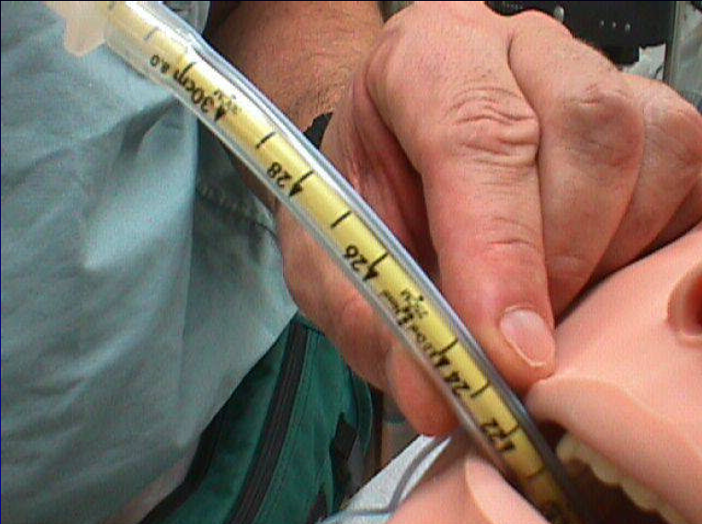
Use of a Tube Changer
Most important job - Keep changer at correct marking at teeth

Slide 88
ET Tube Extubation

Slide 89
Considerations Before Extubation
Assess readiness
Has original need for airway been resolved???
Get permission
Physician order
Protocol

Slide 90
Why Extubation?
Endotracheal tube is no longer needed for…
Ventilation – can breath on their own
Oxygenation – can oxygenate without ET
Airway control – has no obstruction or swelling
Airway protection – has adequate LOC, swallow & gag
Airway clearance – can cough & clear secretions with acceptable production

Slide 91
Why Extubation?
Other Reasons:
Terminal Weaning - Patient in whom further medical care is deemed futile
Obstruction - Acute artificial airway obstruction

Slide 92
Q#57. A 2 yr-old child with croup has been intubated for 4 days with a 4 mm ID uncuffed endotracheal tube. Heated aerosol at an FiO₂ of .21 has been delivered to the intubated patient. The physician asks the therapist to evaluate the patient for possible extubation. Which of the following would most likely indicate that the patient is ready for extubation?
The patient is making normal quiet ventilator efforts
A negative sputum culture and sensitivity has been reported
The patient’s ABGs are within normal range
Breath sounds are heard around the tube on auscultation
15

Slide 93
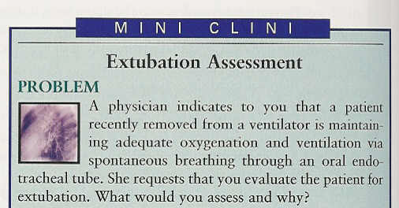

Slide 94
How would you assess before extubation?
Ventilation – Spontaneous breathing trial (SBT)
Oxygenation – SpO₂ with FiO₂ and PEEP at low levels
Airway control – Cuff Leak Test
Airway protection – Check LOC, swallow and gag
Airway clearance – check cough and sputum production

Slide 95
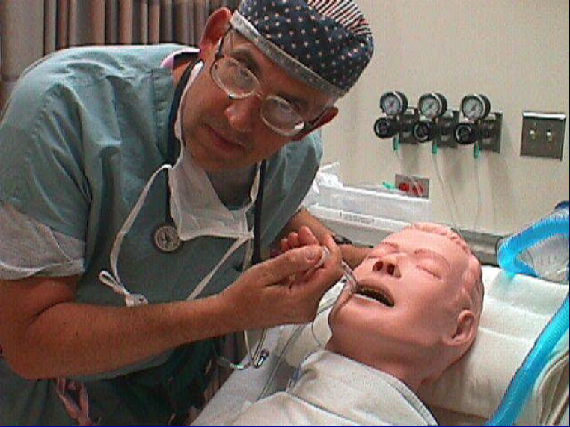
Perform airway cuff leak test
Clear upper airway secretions
Deflate cuff
Occlude tube
Peritubular leak should occur on spontaneous respirations (or with bag ventilation)

Slide 96
What should be done if the patient fails the “Cuff Leak Test”???
Pre-treat with steroids
Pre-treat with racemic epinephrine (alpha agent)
Use cool aerosol set-up rather than nasal cannula after extubation

Slide 97
Preparation for Extubation:
Gather and prepare equipment:
personal protection equipment
suction equipment: open or closed and yankauer
oxygen set up
resuscitation bag & mask
Monitoring equipment (ECG, pulse oximeter…)
10 mL syringe
scissors
treatment nebulizer and Alpha agent (i.e., epi)
re-intubation supplies

Slide 98
Preparation for Extubation:
Prepare yourself:
Wash hands
Put on PPE (gloves and fluid shield)
Prepare the patient:
Discontinue tube feeding 4 – 6 hours prior
Explain procedure to patient
Place patient in semi or high fowlers
Attach pulse oximeter
Hyperoxygenation pre & post suction
Suction oral pharynx and above the cuff
Suction the ETT

Slide 99
Preparation for Extubation:
Prepare the tube:
Deflate the cuff while squeezing the bag or having the patient cough (moves secretions from above cuff to mouth)
QUESTION: Why is it inappropriate to cut the pilot balloon prior to extubation?
The vocal cords would be used to cause cuff deflation
Vocal cord damage could occur
Tube is useless in case emergency reintubation is required.

Slide 100
Preparation for Extubation:
Perform airway cuff leak test *
Clear upper airway secretions
Deflate cuff and occlude tube
Peritubular leak should occur on spontaneous respirations or mechanical breath
Cut the tape

Slide 101
The Extubation Procedure:
Methods for removing the tube:
Have the patient take a deep breath then either
pull tube at peak inspiration (cords open)
cough and pull tube at peak inspiration (cords open)
squeeze the resuscitation bag and pull tube at peak inspiration (cords open)
Not Recommended: Suctioning as the tube is removed

Slide 102
Post - Extubation Procedure:
Have the patient cough to clear any retained secretions.
Apply oxygen device (usually nasal O₂)
Assess patient
Breath sounds and airway patency
Vitals & LOC
Oxygenation (SpO₂)
Ventilation (ABG)
Work of breathing
Ability to clear secretions
Keep patient NPO x 24 hours (ice chips and small water sips only) to prevent post extubation aspiration

Slide 103
Extubation Complications Immediate
Observe for immediate complications associated with:
laryngospasm
glotic edema
supraglottic obstruction
pulmonary aspiration
impaired gas exchange
pulmonary edema

Slide 104
What should be done if the patient develops laryngospasm?
Transient:
Bag & mask ventilation with Oxygen
Persistent:
Neuromuscular blockade
Reintubation

Slide 105
Extubation Complications
IMMEDIATE POST-EXTUBATION COMPLICATIONS
MANAGEMENT
Severe (marked, extreme…) inspiratory stridor or respiratory distress
REINTUBATE
Moderate distress/stridor
Oxygenate, cool mist aerosol and racemic epinephrine, steroids to reduce swelling and possible heli-ox
Mild distress/stridor or sore throat and hoarseness, cough
Provide aerosol therapy, oxygen and/or racemic epinephrine as needed

Slide 106
REINTUBATION STATS
Increases risk of getting nosocomial pneumonia eightfold
Is associated with a 6 – twelvefold increase in mortality
Nearly 80% of patients who self-extubate do not require reintubation

Slide 107
PRACTICE
Do Exercise 24.3 – Extubation
Performance Evaluation

